Slide 1
Lecture 8
Memory Management

Slide 2
The Memory Hierarchy
Processor
4-8 bytes (word)
Inclusive– what is in L1$ is a subset of what is in L2$ is a subset of what is in MM that is a subset of is in SM
Increasing distance from the processor in access time
L1$
8-32 bytes (block)
L2$
1 to 4 blocks
Main Memory
1,024+ bytes (disk sector = page)
Secondary Memory
(Relative) size of the memory at each level

Slide 3
Virtual Memory
Use main memory as a “cache” for secondary memory
Allows efficient and safe sharing of memory among multiple programs
Provides the ability to easily run programs larger than the size of physical memory
Simplifies loading a program for execution by providing for code relocation (i.e., the code can be loaded anywhere in main memory)
What makes it work? – the Principle of Locality
A program is likely to access a relatively small portion of its address space during any period of time
Each program is compiled into its own address space – a “virtual” address space
During run-time each virtual address must be translated to a physical address (an address in main memory)

Slide 4
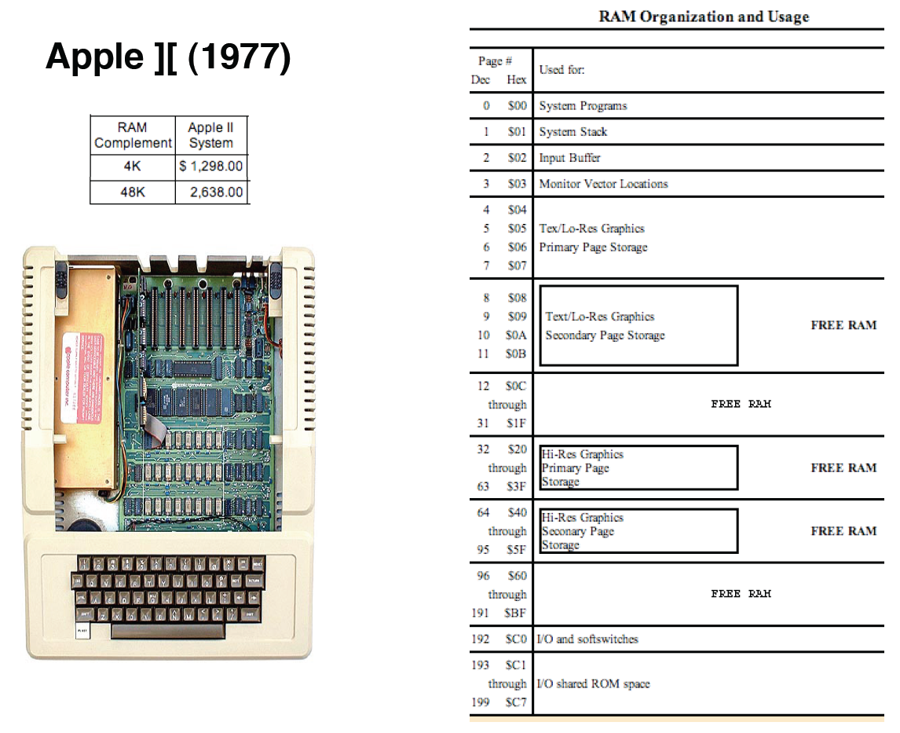
A physically addressed machine

Slide 5
Using physical addressing
All programs share one address space: the physical address space
Machine language programs must be aware of the machine organization
No way to prevent a program from accessing any machine resource

Slide 6
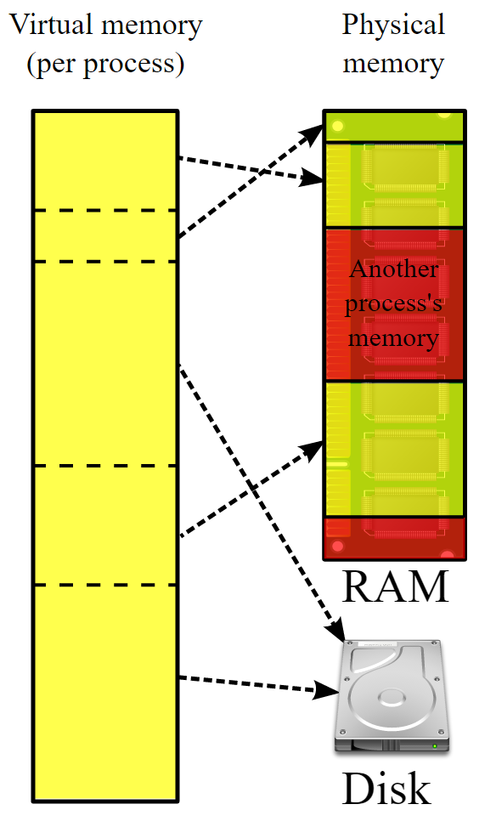
The solution: virtual addressing
User programs run in an standardized virtual address space
Address Translation hardware managed by the operating system (OS) maps virtual address to physical memory
Hardware supports “modern” OS features:
Protection,
Translation,
Sharing

Slide 7
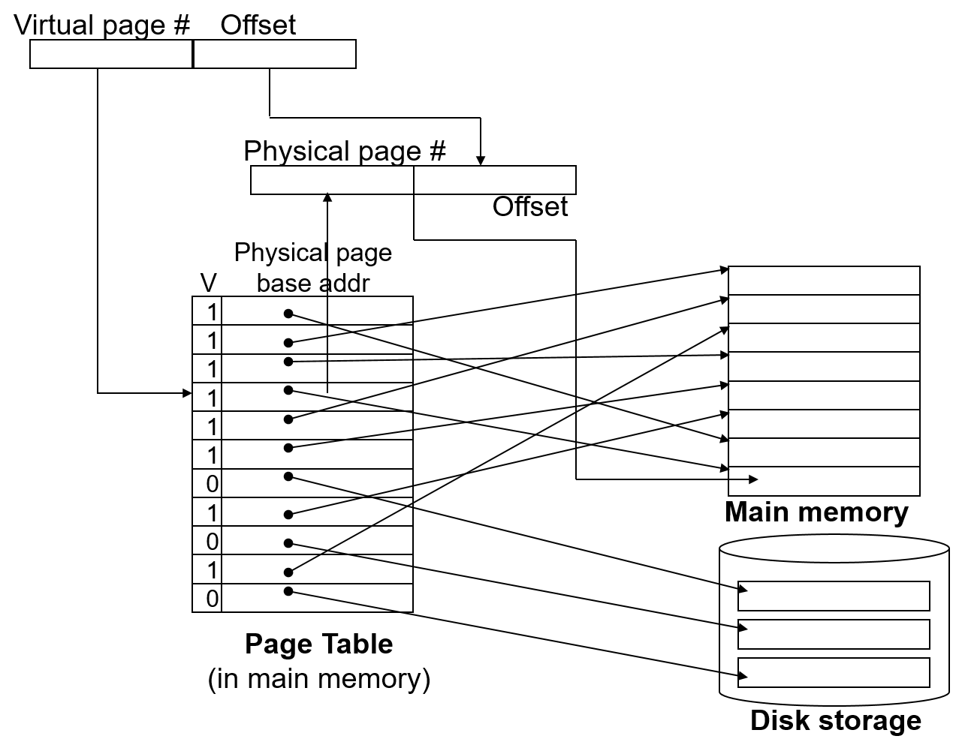
Address Translation Mechanism

Slide 8
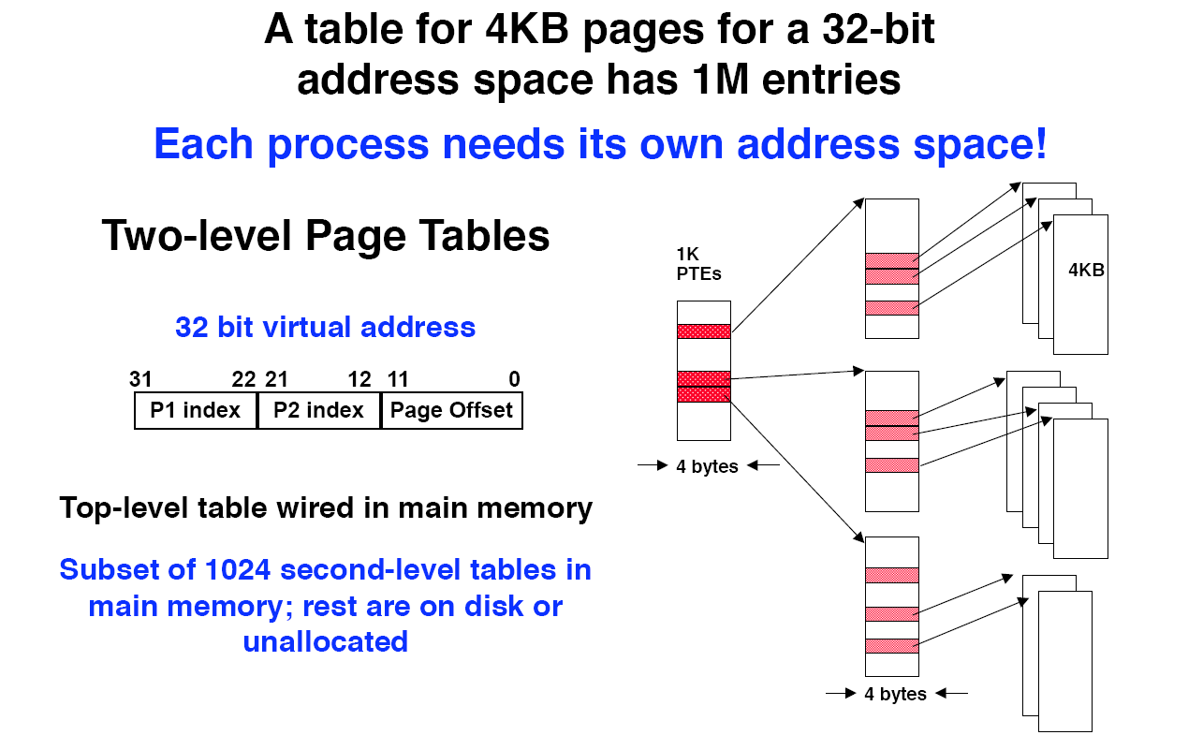
Page tables may not fit in memory!

Slide 9
Virtual Addressing with a Cache
Thus it takes an extra memory access to translate a VA to a PA
VA
Trans-
lation
PA
Cache
miss
Main
Memory
CPU
hit
data
This makes memory (cache) accesses very expensive (if every access was really two accesses)
The hardware fix is to use a Translation Lookaside Buffer (TLB) – a small cache that keeps track of recently used address mappings to avoid having to do a page table lookup

Slide 10
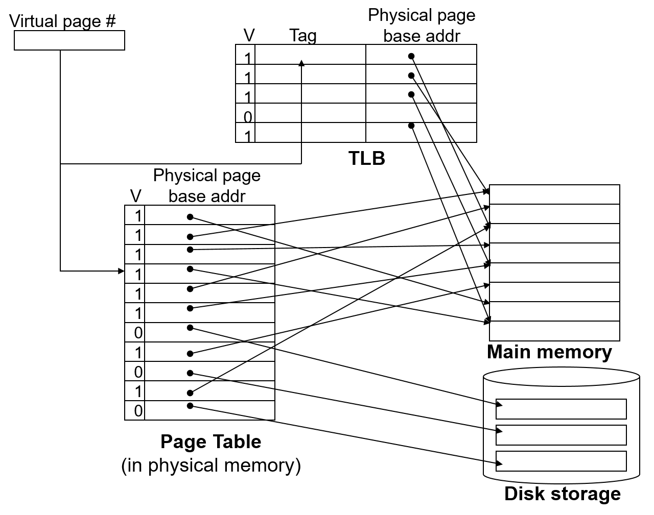
Making Address Translation Fast

Slide 11
Translation Lookaside Buffers (TLBs)
Just like any other cache, the TLB can be organized as fully associative, set associative, or direct mapped
V Virtual Page # Physical Page # Dirty Ref Access
Who is permitted to do what on this page, i.e. access rights.
TLB access time is typically smaller than cache access time (because TLBs are much smaller than caches)
TLBs are typically not more than 128 to 256 entries even on high end machines

Slide 12
A TLB in the Memory Hierarchy
hit
VA
TLB
Lookup
PA
Cache
miss
Main
Memory
CPU
miss
hit
Trans-
lation
data
A TLB miss – is it a page fault or merely a TLB miss?
If the page is loaded into main memory, then the TLB miss can be handled (in hardware or software) by loading the translation information from the page table into the TLB
Takes 10’s of cycles to find and load the translation info into the TLB
If the page is not in main memory, then it’s a true page fault
Takes 1,000,000’s of cycles to service a page fault
TLB misses are much more frequent than true page faults

Slide 13
Memory in the Linux Kernel

Slide 14
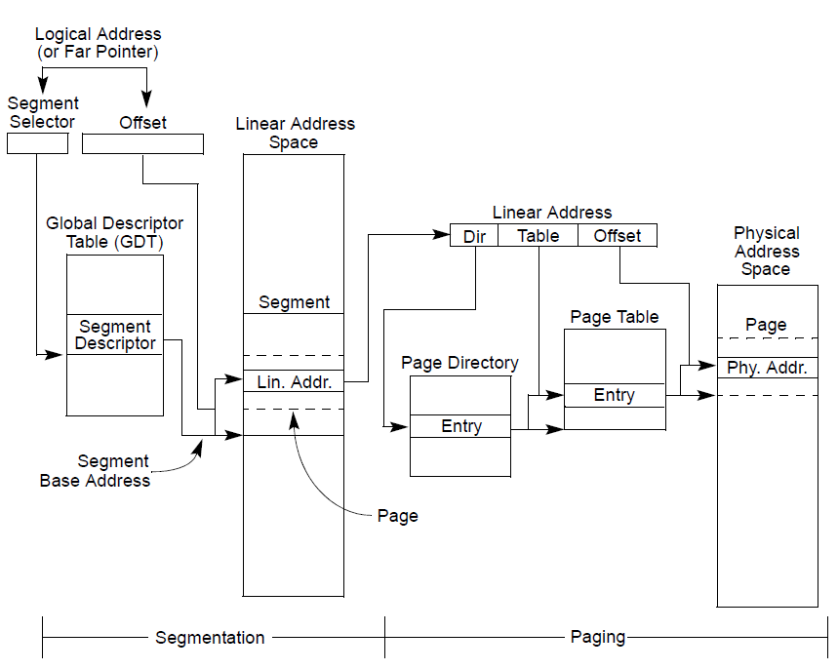
Memory addressing – Segmentation and Paging

Slide 15
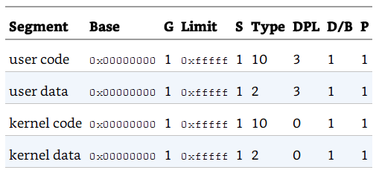
Getting segmentation out of the way
Only use segmentation when it has to
Addresses are linear
Make 0x00000000 the base of all “segments”
“True” address is in the offset

Slide 16
Paging in Linux-x86
(Contiguous) linear addresses are grouped in fixed length intervals call pages
On x86, a page is 4KB (with later extension to support larger pages)
Physical memory is partitioned into fixed length page frames (or simply called frames)
One page frame contains a single page
Linear addresses are translated to physical addresses using page tables
Page is turned on in x86 by setting the PG bit in CR0
The root page table is pointed to by the page directory base register field in CR3

Slide 17
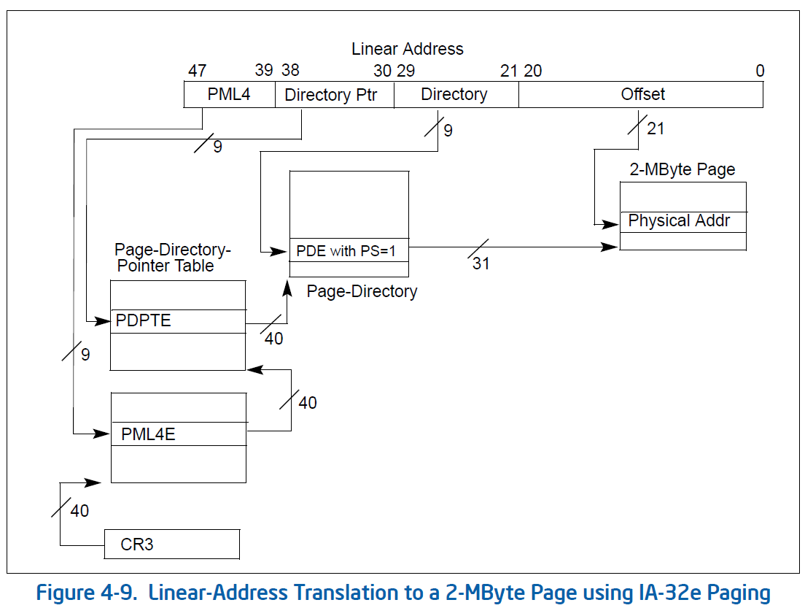
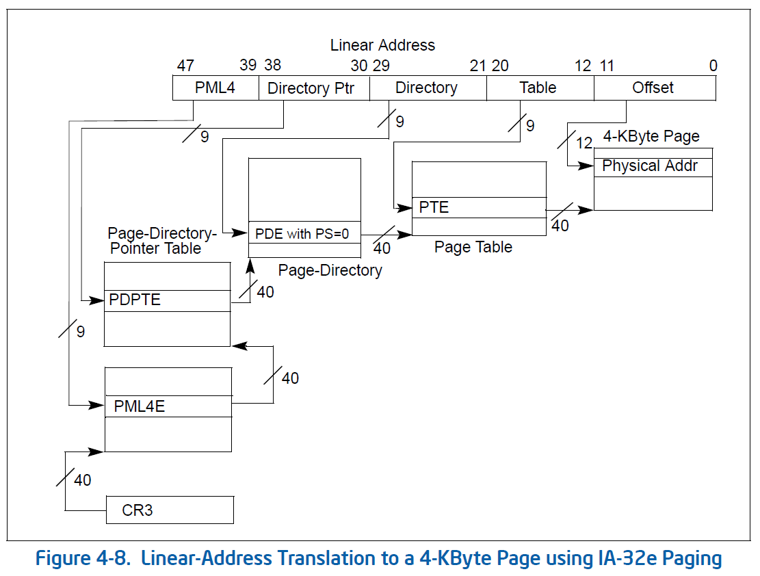
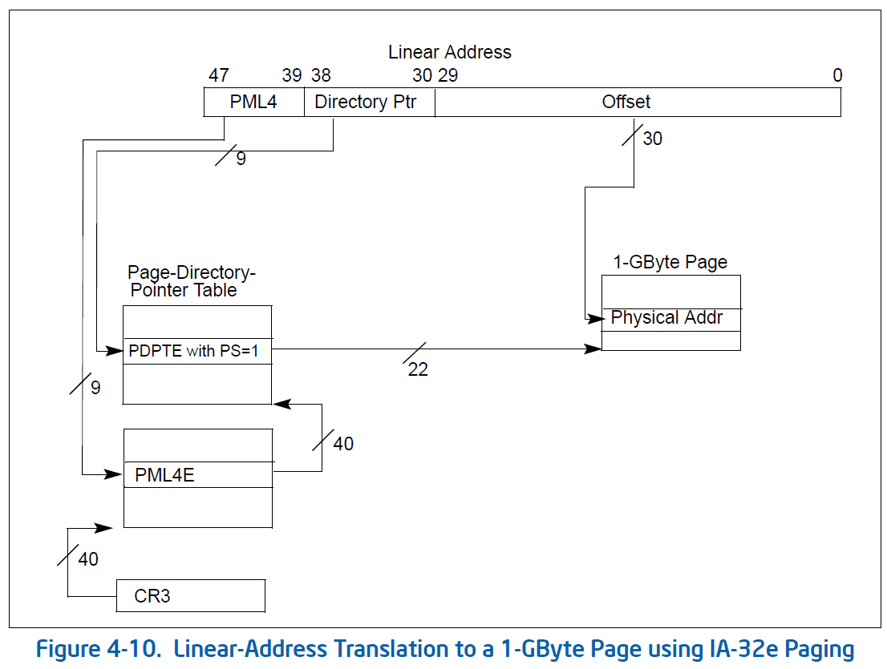
Paging in 64 bits

Slide 18
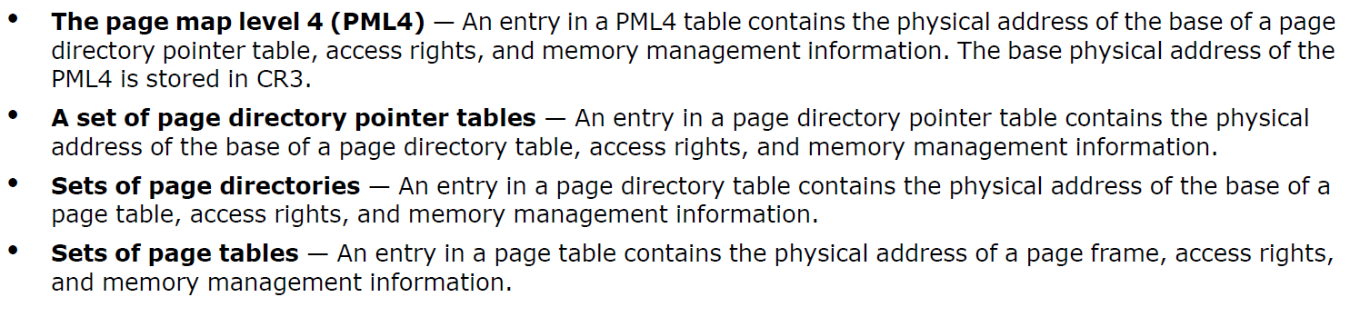
Four level page tables

Slide 19
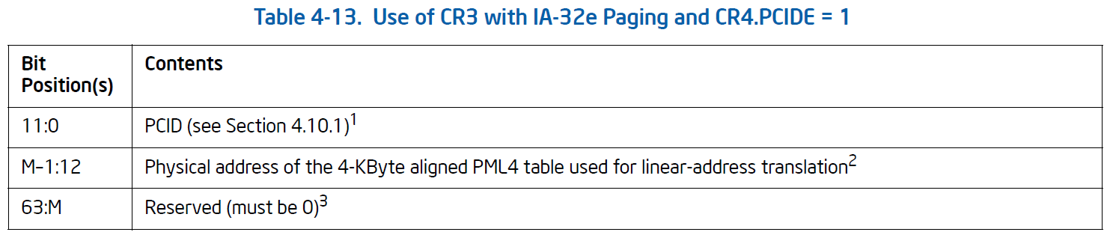
CR3

Slide 20
Process Context ID (PCID)
In other processors also known as the address space ID (ASID)
Enable faster context switching
Used to distinguish one process’ address space from another
12 bits in length
Affects how TLB works
Value of 0 reserved for various condition checking
Linux use it on a per-CPU basis instead of a global ASID

Slide 21
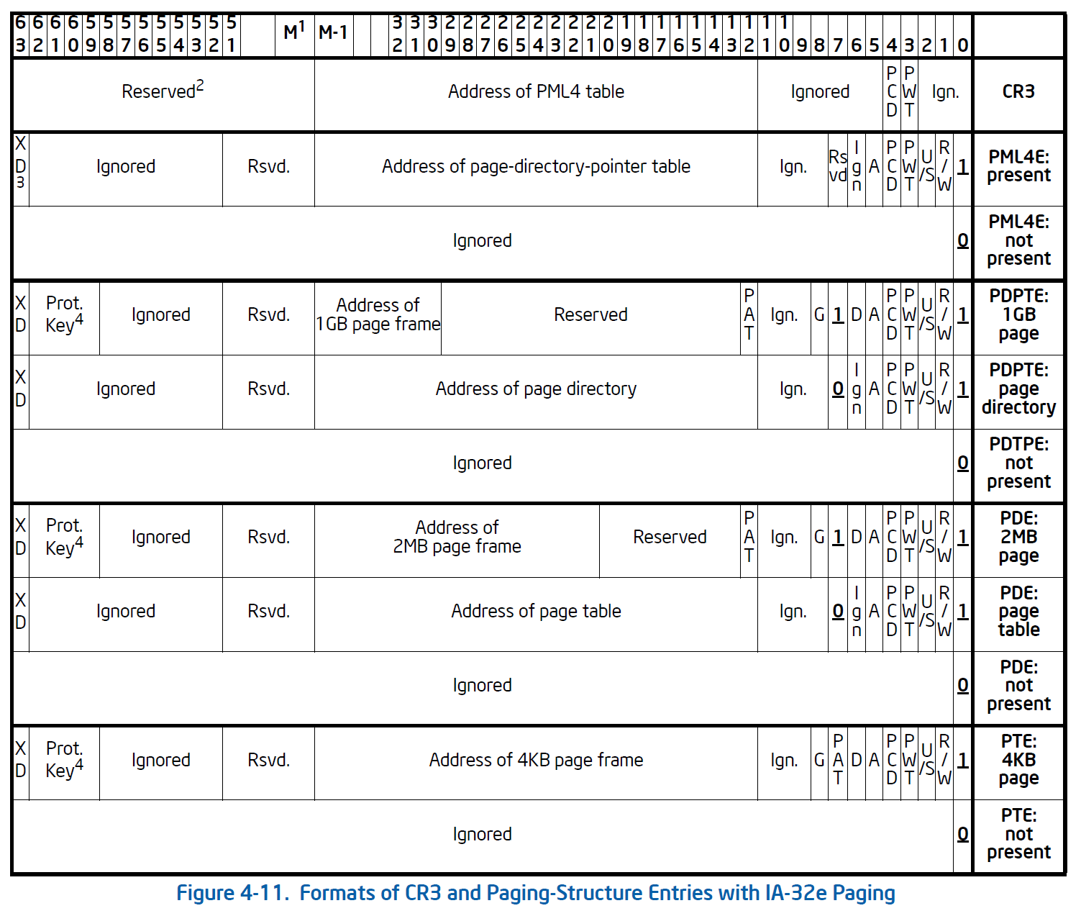
The Table Entries

Slide 22
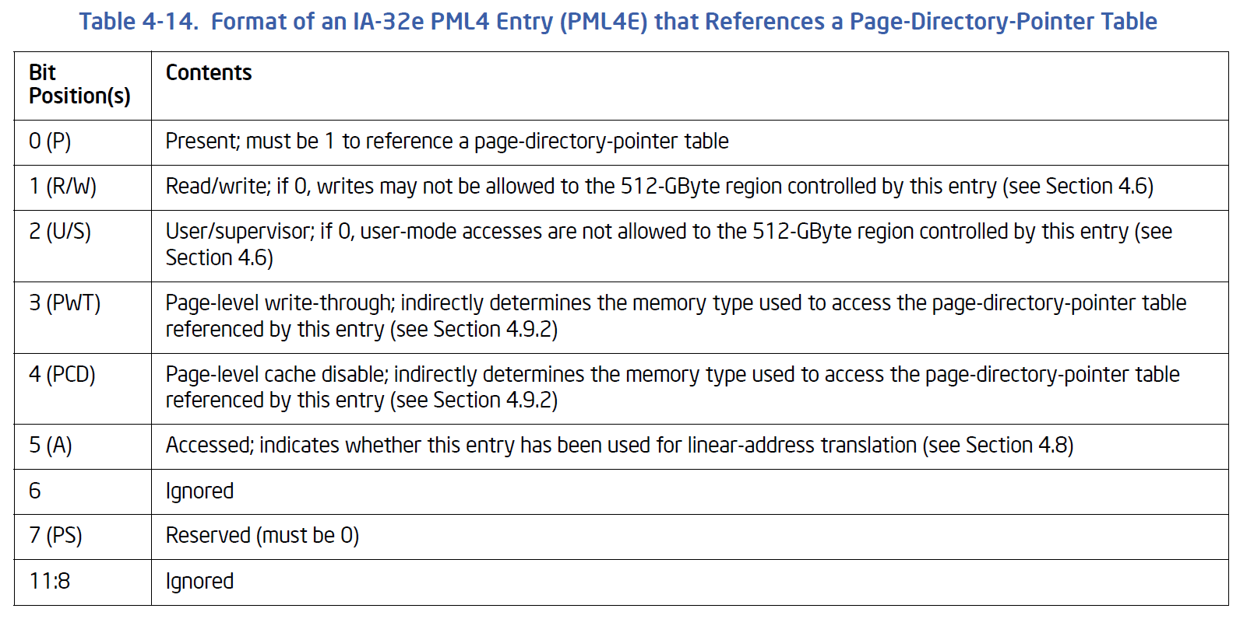
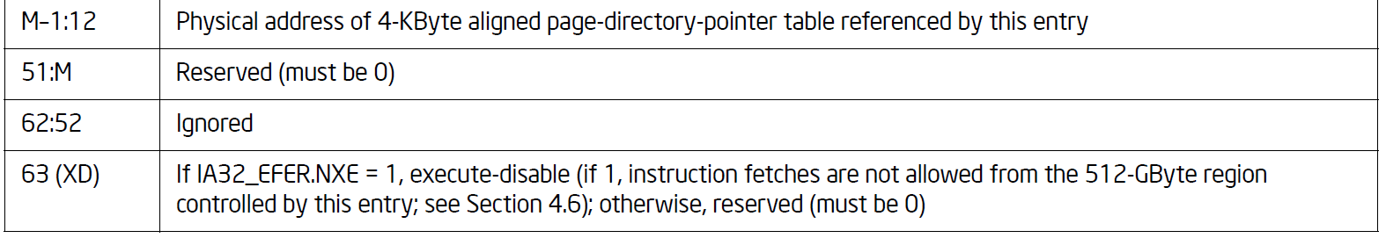
PML4’s 64 bit entry
M = Max physical address length supported by this processor

Slide 23
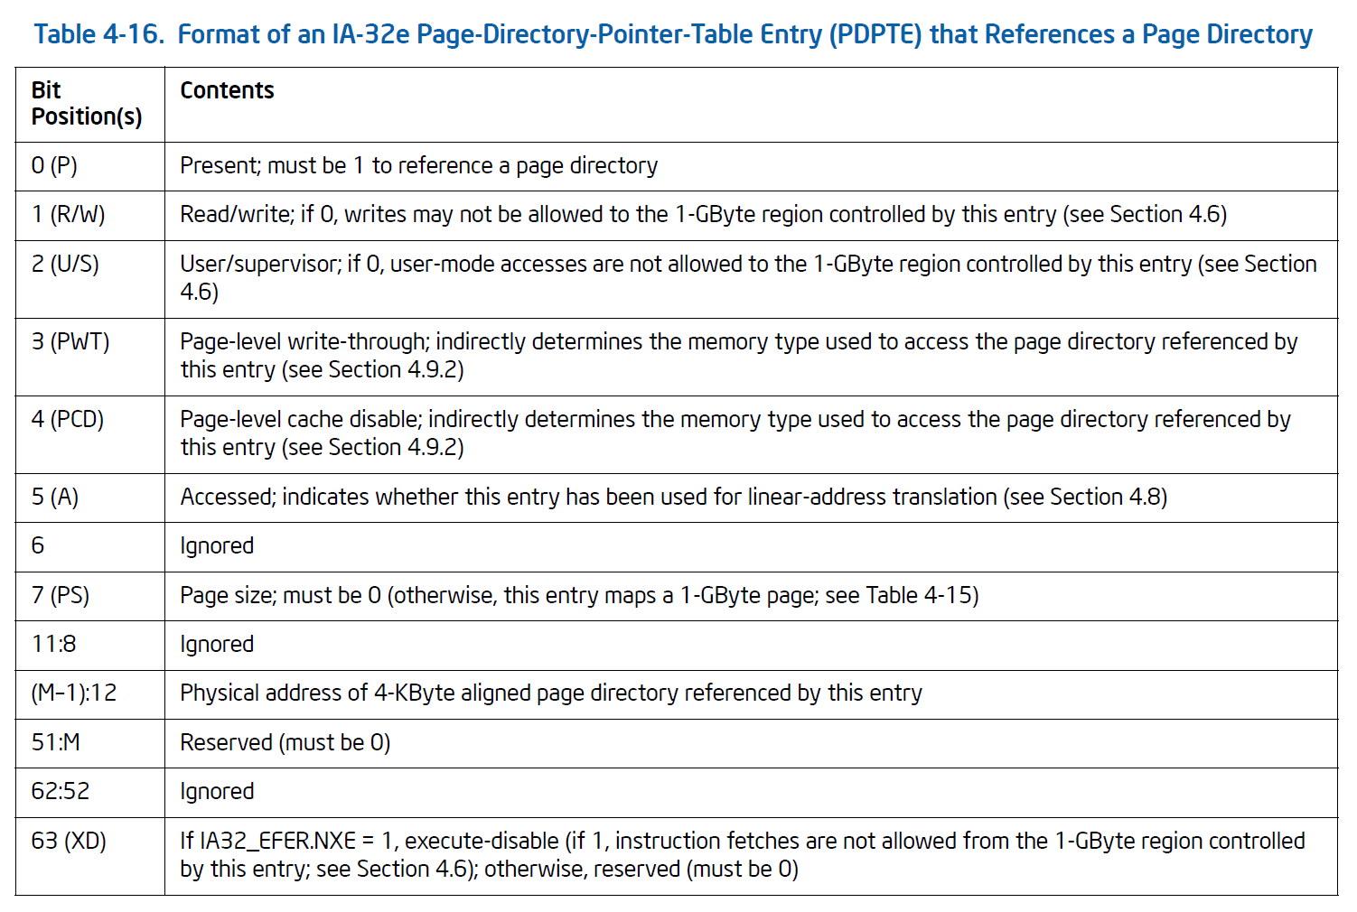
Page Directory Pointer Table Entry

Slide 24
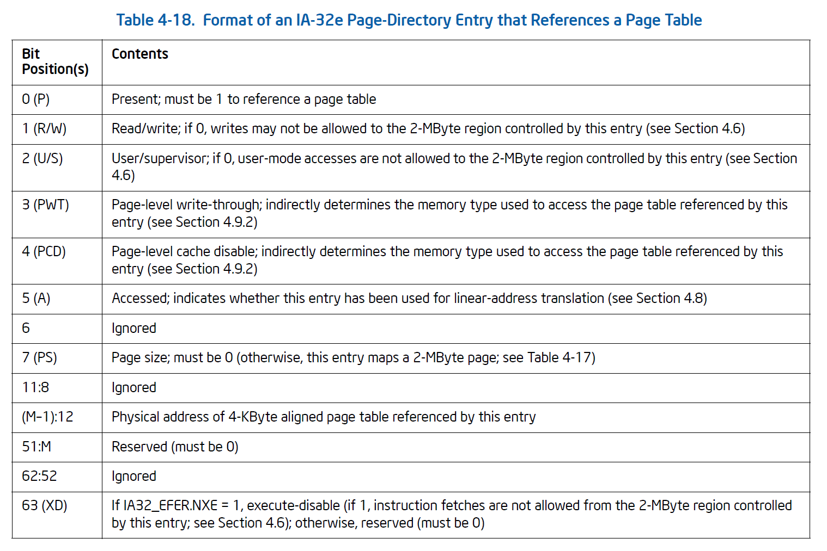
Page Directory Entry

Slide 25
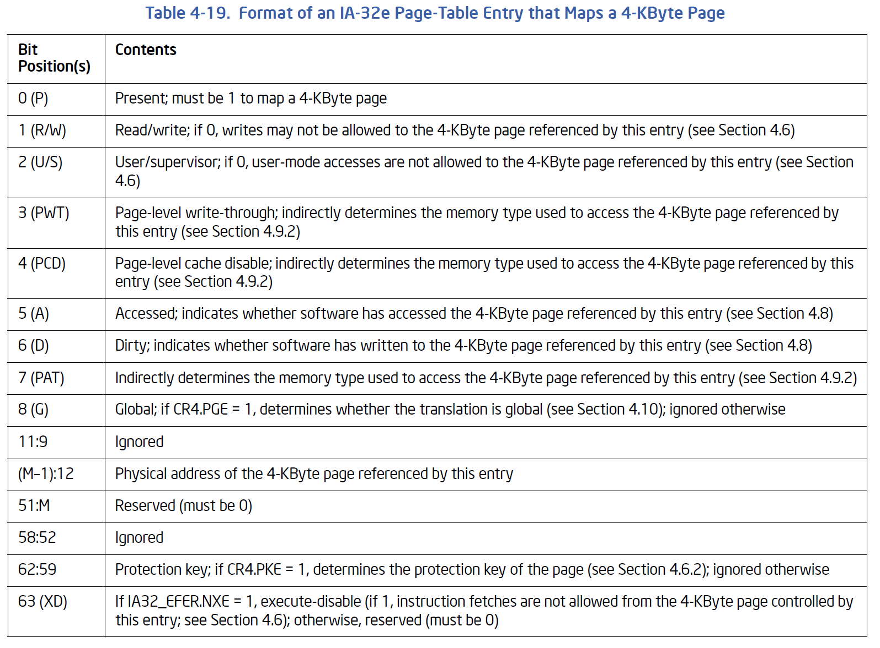
Page Table Entry for 4K Pages

Slide 26
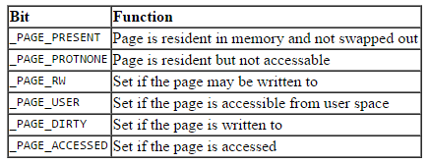
PTE protection and status bits

Slide 27
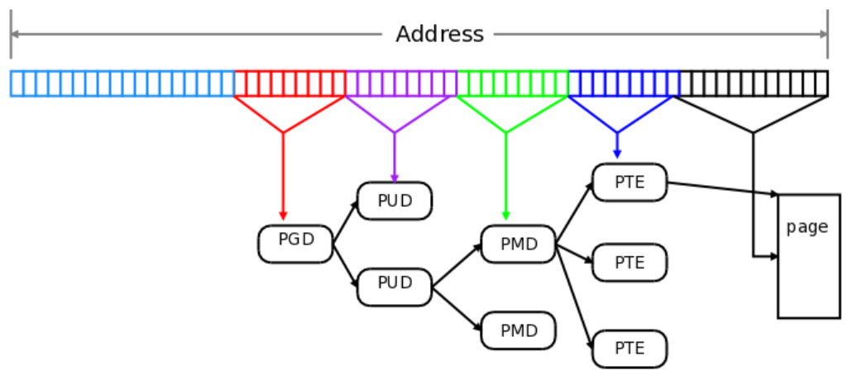
Linux and x86-64 paging
Linux supports 4 level paging:
Intel PML4 ⇨Linux Page Global Directory (PGD)
Intel Page Directory Pointer Table ⇨Linux Page Upper Directory (PUD)
Intel Page Directory ⇨Linux Page Middle Directory (PMD)
Intel Page Table ⇨Linux Page Table (PTE)
Source: https://lwn.net/Articles/717293/

Slide 28
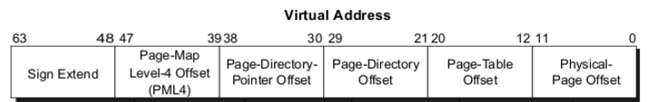
Key constants
PAGE_SHIFT
PAGE_MASK
PAGE_SIZE
PMD_SHIFT
PMD_MASK
PMD_SIZE
PUD_SHIFT
PUD_MASK
PUD_SIZE
PGDIR_SHIFT
PGDIR_MASK
PGDIR_SIZE

Slide 29
And then there was 5!
But 4 level tables still has lots of unused space
A new level, P4D, is inserted between the PGD and the PUD
Merged since kernel version 4.11-rc2
But to date, there is no physical hardware support for 5 level paging
Systems running with five-level paging will support 52-bit physical addresses and 57-bit virtual addresses

Slide 30
Canonical Addresses
“No processors supporting the Intel 64 architecture support more than 48 physical-address bits.”
The 16-bits (bits 63-48) of any 64-bit address must be a “sign extension” of Bit 47.
Such an address is known as a canonical address.
Intel manual says: “If a linear-memory reference is not in canonical form, the implementation should generate an exception.”

Slide 31
Physical Page Layout
During initialization, kernel builds a physical address map
It identifies the reserved page frames that includes
Frames that are outside the available physical address range
Frames containing kernel code and initialized data structures
A page contained in a reserved page frame can never be dynamically assigned or swapped to disk.
Generally, Linux kernel is in RAM starting from physical address 0x00100000
Gives deference to the BIOS

Slide 32
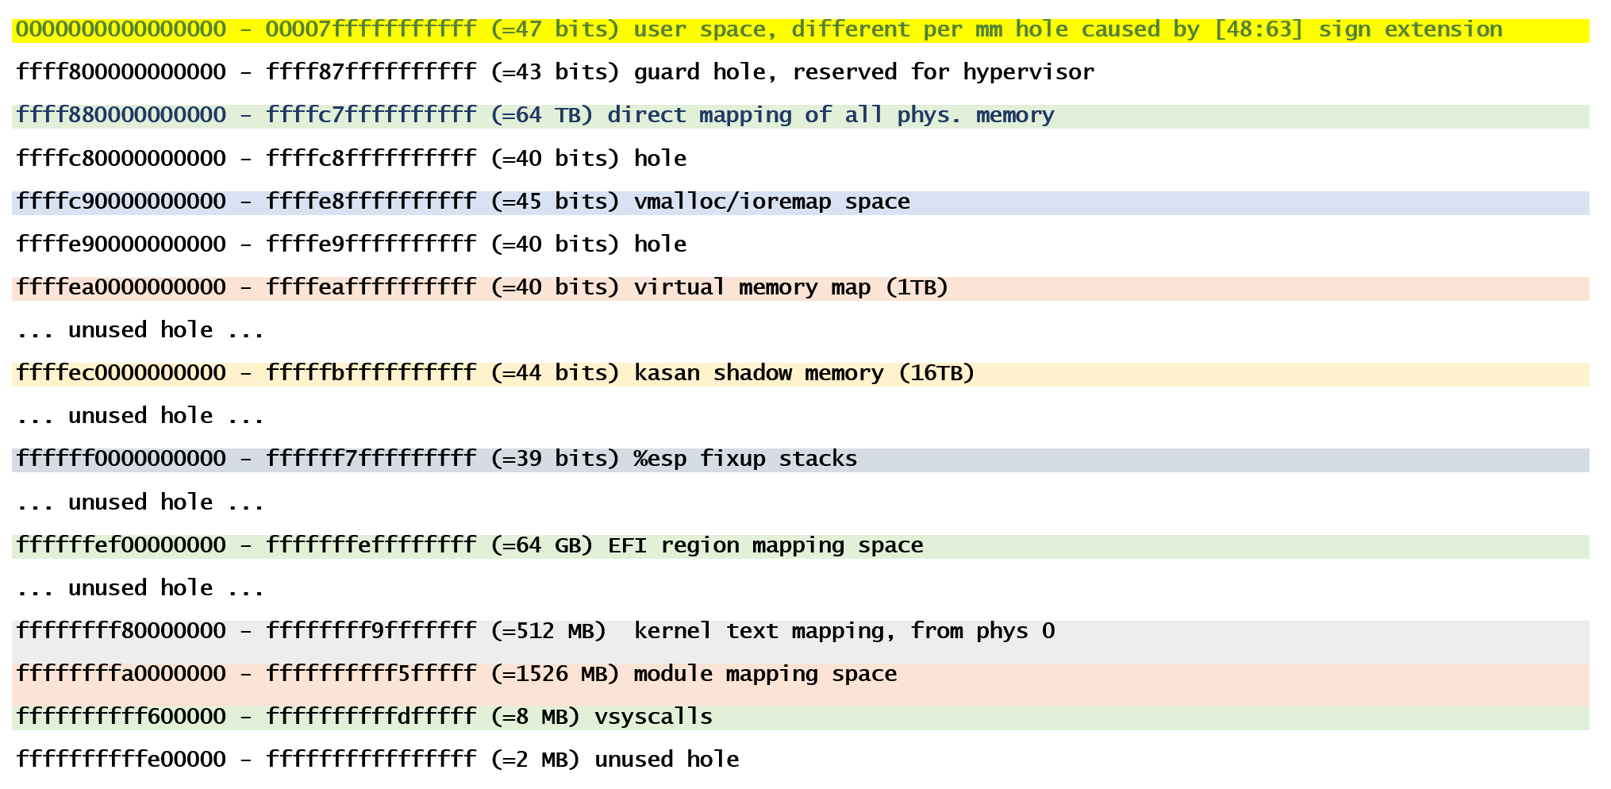
The 64-bit Linux Memory Map

Slide 33
View from 30,000 feet
Process 1
Process 2
User
Space
User
Space
Some parts of user space of any process maps to parts of physical memory
ALL of physical memory maps to a fixed region in kernel space
Some parts of kernel space will map into parts of physical memory (vmalloc/ioremap)
maps to
maps to
Physical
Memory
Kernel
Space
Kernel
Space
Virtual
Address
Space
Virtual
Address
Space

Slide 34
Master Kernel Page Tables
The kernel uses a single set of page tables
Never directly used but changes need to be propagated to all processes
Sharing at PGD level
Pointed to by the root variable swapper_pg_dir
Set up during initialization
Held in a master memory descriptor (init_mm)
It is the page tables of Process 0
A copy of the kernel page tables is in every process
Updating it is very expensive – but only needed when a new kernel PGD entry is added
Uses a “deferred” approach by reference to the master copy

Slide 35
Direct mapping
All of the available physical memory is mapped into the kernel virtual space as a contiguous block starting from __PAGE_OFFSET
Gives kernel full and easy access to any page frame
Protection has to be in place
For 32-bit, can be configured; normally __PAGE_OFFSET is 0xC00000000
For 64-bit, __PAGE_OFFSET is 0xffff880000000000

Slide 36
VMALLOC
Kernel can allocate, deallocate non-contiguous memory using the vmalloc() and vfree() calls
Works in a way similar to user level malloc() and free()

Slide 37
fixmap addresses
A fix-mapped linear address is a constant linear address whose corresponding physical address does not have to be the linear address minus __PAGE_OFFSET, but rather a physical address set in an arbitrary way
Used for supporting special hardware like APIC
Also used for vsyscall implementation

Slide 38
Kernel and the Cache
The most frequently used fields of a data structure are placed at the low offset within the data structure, so they can be cached in the same line.
When allocating a large set of data structures, the kernel tries to store each of them in memory in such a way that all cache lines are used uniformly.

Slide 39
Working with the TLB
It is the kernel, and not the hardware, that decides when a mapping between a linear and a physical address is no longer valid.
Entire TLB may be flushed by certain changes
Such as changing CR3
Or individual TLB entry
‘invlpg m’ x86 instruction will invalidate the TLB entry containing the address m.

Slide 40
Avoiding TLB flushes
TLB flush not needed if:
The next process selected for scheduling has the same set of page tables as the current one
Scheduler selects a kernel thread
It “uses” the same page tables as the current process
Kernel space is largely the same for all processes

Slide 41
Page Descriptor
“struct page” in include/linux/mm_types.h
One per page frame
32 bytes or more
Keeps the key information about the page frame including permissions, reference counts etc.

Slide 42
Page Table Isolation

Slide 43
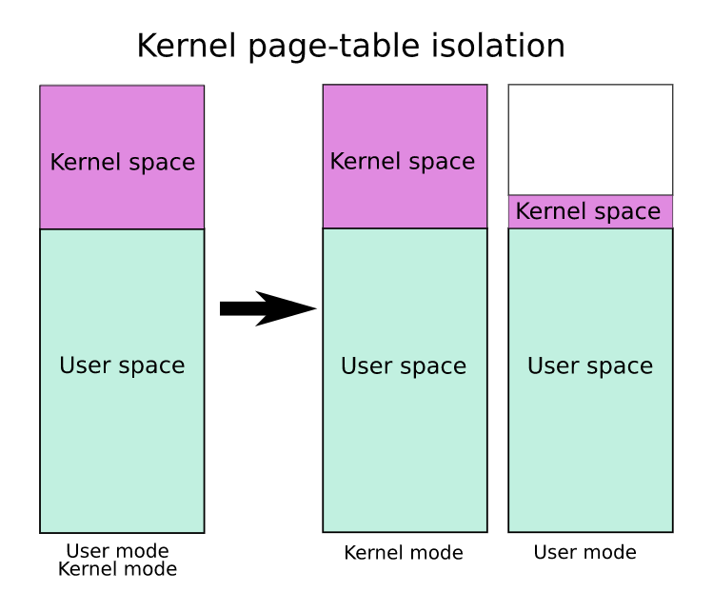
Page Table Isolation (PTI)
Previously known as KAISER
Countermeasure against attacks on the shared user/kernel address space
Basic idea:
Two sets of page tables
When the kernel is entered via syscalls, interrupts or exceptions, the page tables are switched to the full “kernel” copy
When the system switches back to user mode, the user copy is used again
The userspace page tables contain only a minimal amount of kernel data

Slide 44
The full set of page tables
A complete mapping of userspace that the kernel can use for things like copy_to_user()
The user portion of the kernel page tables is crippled by setting the “not executable” (NX) bit in the top level
Any mistake in switching CR3 to userspace will cause an exception

Slide 45
The userspace page mapping
Userspace page tables map only the kernel data needed to enter and exit the kernel
This data is entirely contained in the struct cpu_entry_area structure
Ensures in userspace cannot access the bulk of kernel mappings

Slide 46
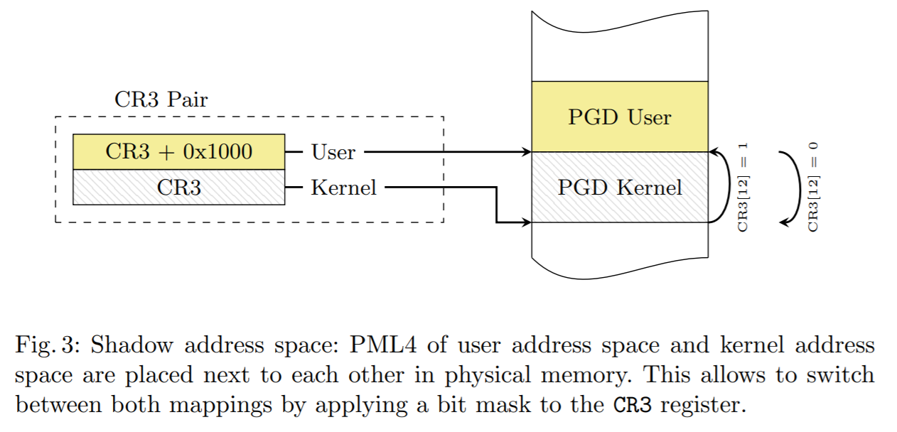
Shadowed CR3
Source: https://gruss.cc/files/kaiser.pdf

Slide 47
Linux Memory Management

Slide 48
Virtual memory of a process
First set up by the loader using the ELF of the application
Heap area virtual pages are allocated using brk()
Alternatively, files can be mmap() into the virtual address space

Slide 49
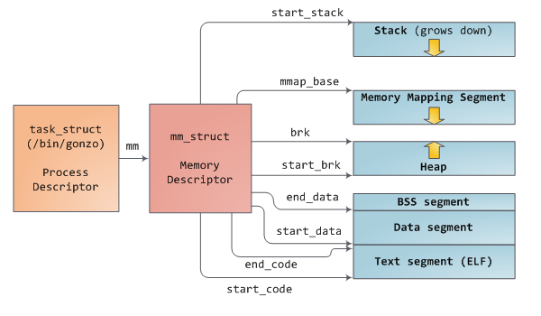
User Level Processes
Source: http://duartes.org/gustavo/blog/post/how-the-kernel-manages-your-memory/

Slide 50
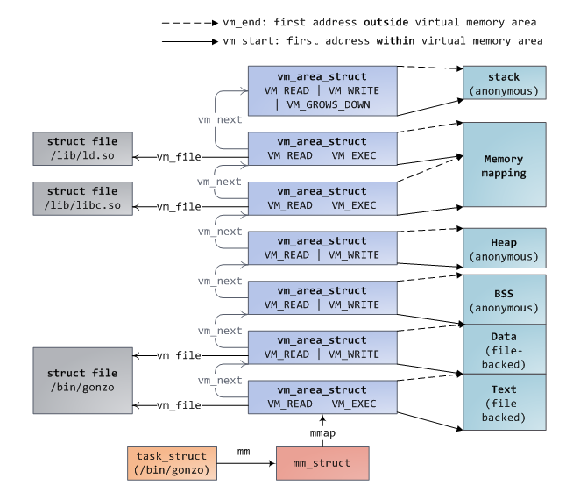
Virtual Memory Area
Also called a (virtual) memory region
Source: http://duartes.org/gustavo/blog/post/how-the-kernel-manages-your-memory/

Slide 51
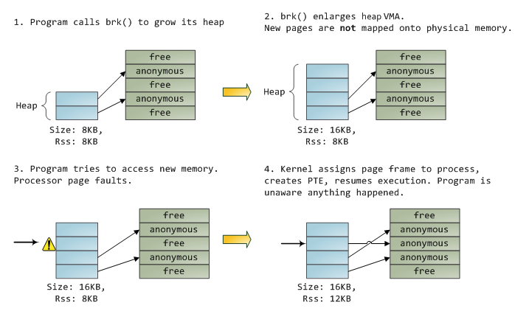
Lazy Expansion
Source: http://duartes.org/gustavo/blog/post/how-the-kernel-manages-your-memory/

Slide 52
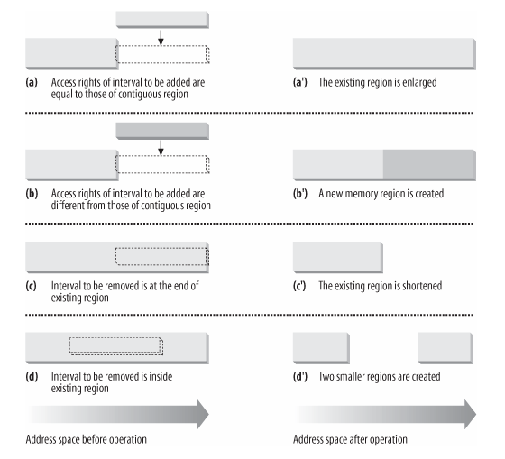
VMA operations
When a new file is mmap’ed
When a new shared memory segment is created

Slide 53
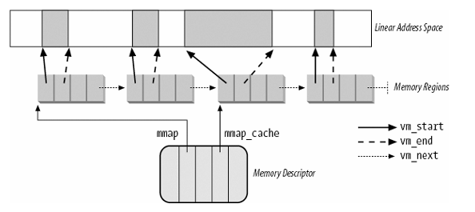
Searching the VMA
A frequent operation is to find the region a virtual address is in
Either using the linked list to search linearly
Or (for processes with many memory regions) - a red-black tree

Slide 54
On Physical Memory

Slide 55
Memory Zone
Physical memory is divided into zones
One major reason: direct-memory access
Devices read/write data directly into memory without CPU involvement after setup

Slide 56
Direct Memory Access
Hardware subsystem direct access to memory independent of CPU
Frees up the CPU
Can also be used for memory to memory copying, or scatter-gather operations
Used by many including disk drive controllers, graphics cards, network cards and sound cards.

Slide 57
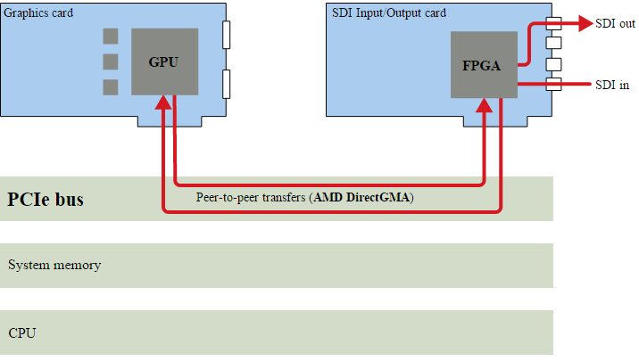
Example: AMD DirectGMA

Slide 58
DMA modes of operations
Burst mode / Block transfer mode
DMA controls bus and fastest in transfer
Cycle stealing mode
Interleave bus with CPU
Transparent mode
Slowest mode: DMA uses bus only when CPU is not

Slide 59
The trouble with DMA
DMA works only with physical addresses
OS must set it up
Legacy DMA have limited address bits
Legacy x86 only up to 16MB of physical memory
PCI-e can do 32 or 64 bit DMA
64-bit almost never implemented/used

Slide 60
Memory Zone
Part of physical memory must be set aside for DMA use
And they must be in certain ranges
In x86-64, ZONE_DMA (16MB) and ZONE_DMA32 (4GB)
Others: ZONE_NORMAL, ZONE_HIGHMEM, ZONE_DEVICE
Page allocation must be done to the correct zone

Slide 61
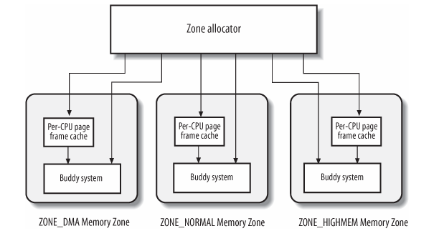
The Zoned Page Frame Allocator
Zone allocator receives requests for allocation and deallocation of dynamic memory
Actual work done by the Buddy System Algorithm
For better performance, a small cache is used for fast, single frame allocation requests

Slide 62
Reserved Page Frame Pool
In normal memory allocation, if not enough free memory, must put request on hold then do memory reclamation
But some request must not block in the kernel (GFP_ATOMIC), e.g. inside interrupt servicing routines
Solution: reserve a small amount of free memory for atomic allocation
Need to “top up” if too low

Slide 63
Different needs
kmalloc() and kfree()
Allocates contiguous physical memory
A “must” for DMA especially
vmalloc() and vfree()
Allocates contiguous virtual memory
Strictly for use inside the kernel

Slide 64
External Fragmentation
Allocation and deallocation of groups of contiguous page frames of different sizes may lead to a situation of several small blocks of free page frames scattered inside blocks of allocated page frames
Linux uses the Buddy Allocation Algorithm

Slide 65
The Buddy System Algorithm
Used by the kernel for allocating groups of contiguous page frames. (mm/page_alloc.c)
All free page frames are grouped into 11 lists of blocks that contain groups of 1 (2⁰), 2 (2¹), 4 (2²), 8 (2³), 16 (2⁴), 32 (2⁵), 64 (2⁶), 128 (2⁷), 256 (2⁸), 512 (2⁹), and 1024 (2¹⁰) contiguous page frames
The physical address of the first page frame of a block is a multiple of the group size.
E.g. the initial address of a 16-page-frame block is a multiple of 16 x 4096 (4K page)

Slide 66
Allocating memory via the Buddy System
The algorithm for allocating, for example, a block of 256 contiguous page frames
First checks for a free block in the 256-page-frame list
If no free block, it then looks in the 512-page-frame list for a free block
If it finds a block, the kernel allocates 256 of the 512 page frames and puts the remaining 256 into the list of free 256-page-frame blocks.
If no free 512-page block, kernel looks at the next larger list (i.e., a free 1024-page-frame block) allocating it and dividing the block similarly
If no block can be allocated an error is reported

Slide 67
Reclaiming memory in the Buddy System
The kernel attempts to merge pairs of free buddy blocks of size b together into a single block of size 2b. Two blocks are considered buddies if:
Both have the same size.
They are located in contiguous physical addresses.
The physical address of the first page frame of the first block is a multiple of 2 x b x 2¹².
This is an iterative algorithm; if it successfully merges released blocks, b is doubled and bigger blocks are attempted.

Slide 68
Buddy System Data Structures
Linux 2.6 uses a different buddy system for each zone. Each one relies on the following main data structures:
mem_map array – contains all the page frame descriptors on the system
An array having 11 elements of type free_area, one element for each group size.

Slide 69
Interfaces
Buddy algorithm triggered in alloc_pages() and free_pages()
Real work done in __rmqueue() and __free_pages_bulk() in page_alloc.c
“GFP” – “get free pages”

Slide 70
/proc/buddyinfo
Used primarily for diagnosing memory fragmentation issues. Using the buddy algorithm, each column represents the number of pages of a certain order (a certain size) that are available at any given time.
The DMA row references the first 16 MB on a system, the HighMem row references all memory greater than 4 GB on a system, and the Normal row references all memory in between.
Node 0, zone | DMA | 90 | 6 | 2 | 1 | 1 | …
Node 0, zone | Normal | 1650 | 310 | 5 | 0 | 0 | …
Node 0, zone | HighMem | 2 | 0 | 0 | 1 | 1 | …

Slide 71
Per-CPU Page Frame Cache
For each CPU, pre-allocate some page frames to be used by that CPU
Hot cache
Good if kernel or user mode process running on that CPU will write immediately to the frame
Cold cache
For DMA operation
Interface: buffered_rmqueue()

Slide 72
Internal Fragmentation
Buddy algorithm eliminates external fragmentation (between pages)
But internal fragmentation still an issue
Objects smaller than a page
Objects of different sizes are allocated and freed, resulting in “holes” inside a page

Slide 73
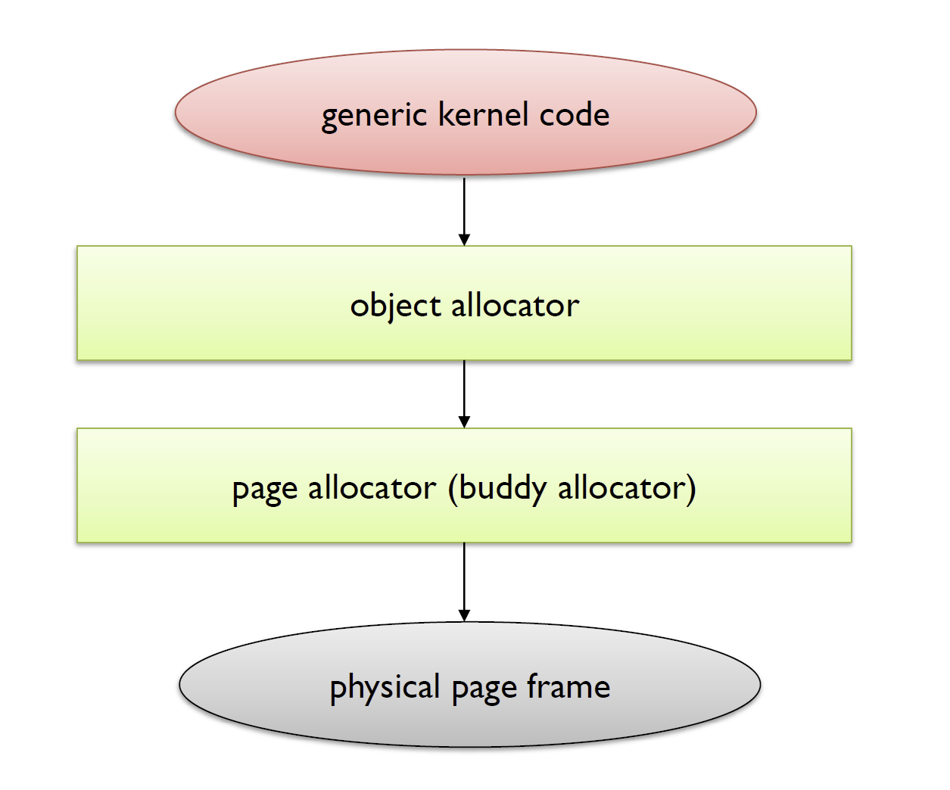
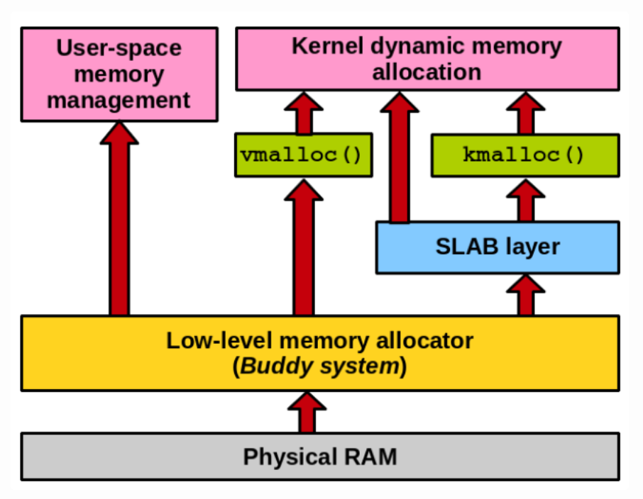
The memory allocators

Slide 74
vmalloc() vs kmalloc()
Both are memory allocators for the kernel
kmalloc()
Allocated pages are physically as well as virtually contiguous
GFP flags
GFP_ATOMIC – atomic (either succeed or fail), never sleeps, highest priority
GFP_KERNEL – “normal”, allowed to sleep
vmalloc()
Allocated pages are virtually contiguous but not necessarily physical contiguous
The kernel’s malloc()
Will still work if there is insufficient physical memory

Slide 75
Kernel Object Allocators

Slide 76
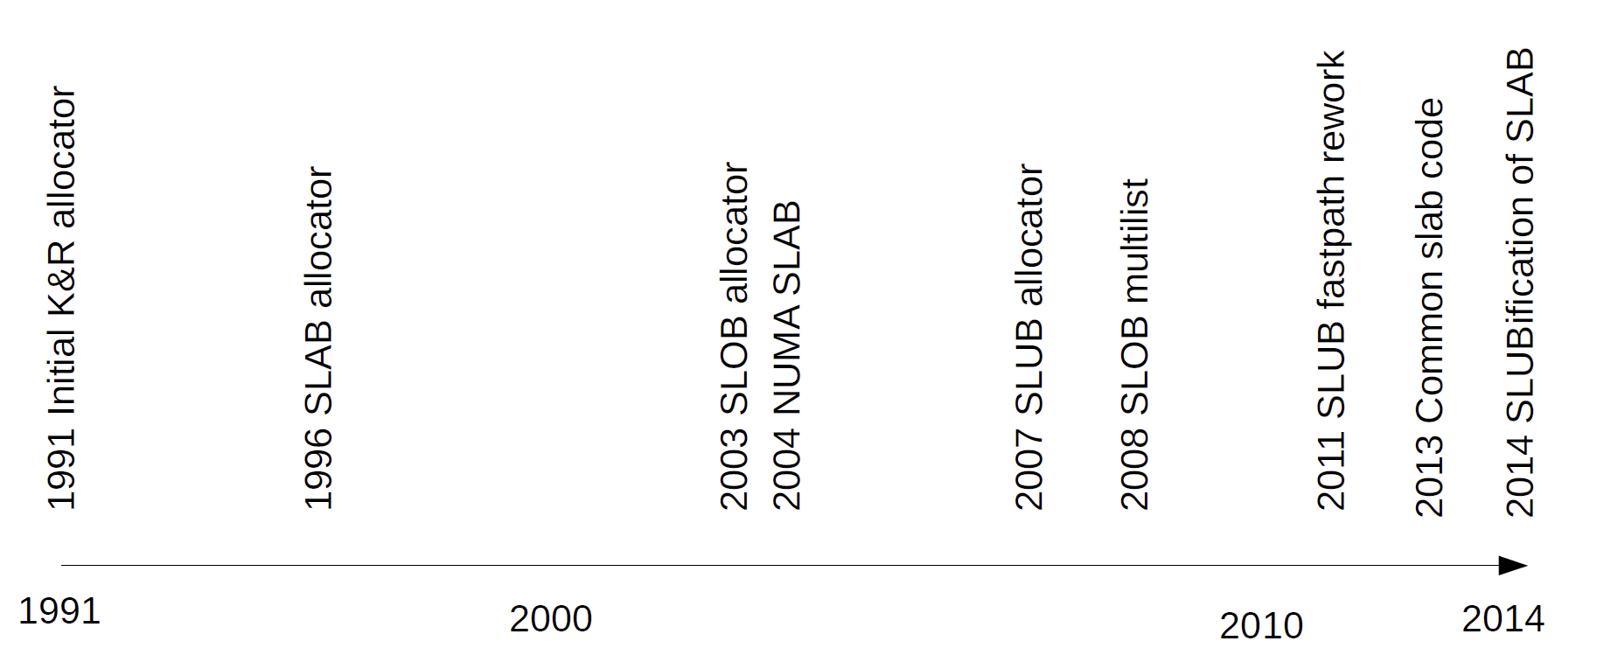
The Kernel Object Allocators
SLOB (Simple List of Blocks) – K&R 1999 vintage
Goal: compactness of memory, minimum memory overhead
SLAB – Pioneered by Solaris OS
Goal: cache friendly, waste some space to gain cache efficiency
SLUB – current
Goal: speed

Slide 77
The SLOB Allocator
First proposal: first-fit
Single list of allocated and free space
Object allocation: find first free space that is bigger than requested, cut it up and allocate to requester; if none available, enlarge the heap
Object deallocation: try to merge with neighbouring free space
1st optimization: use list of different object sizes
2nd optimization: best-fit
Search for the smallest in list that will satisfy request

Slide 78
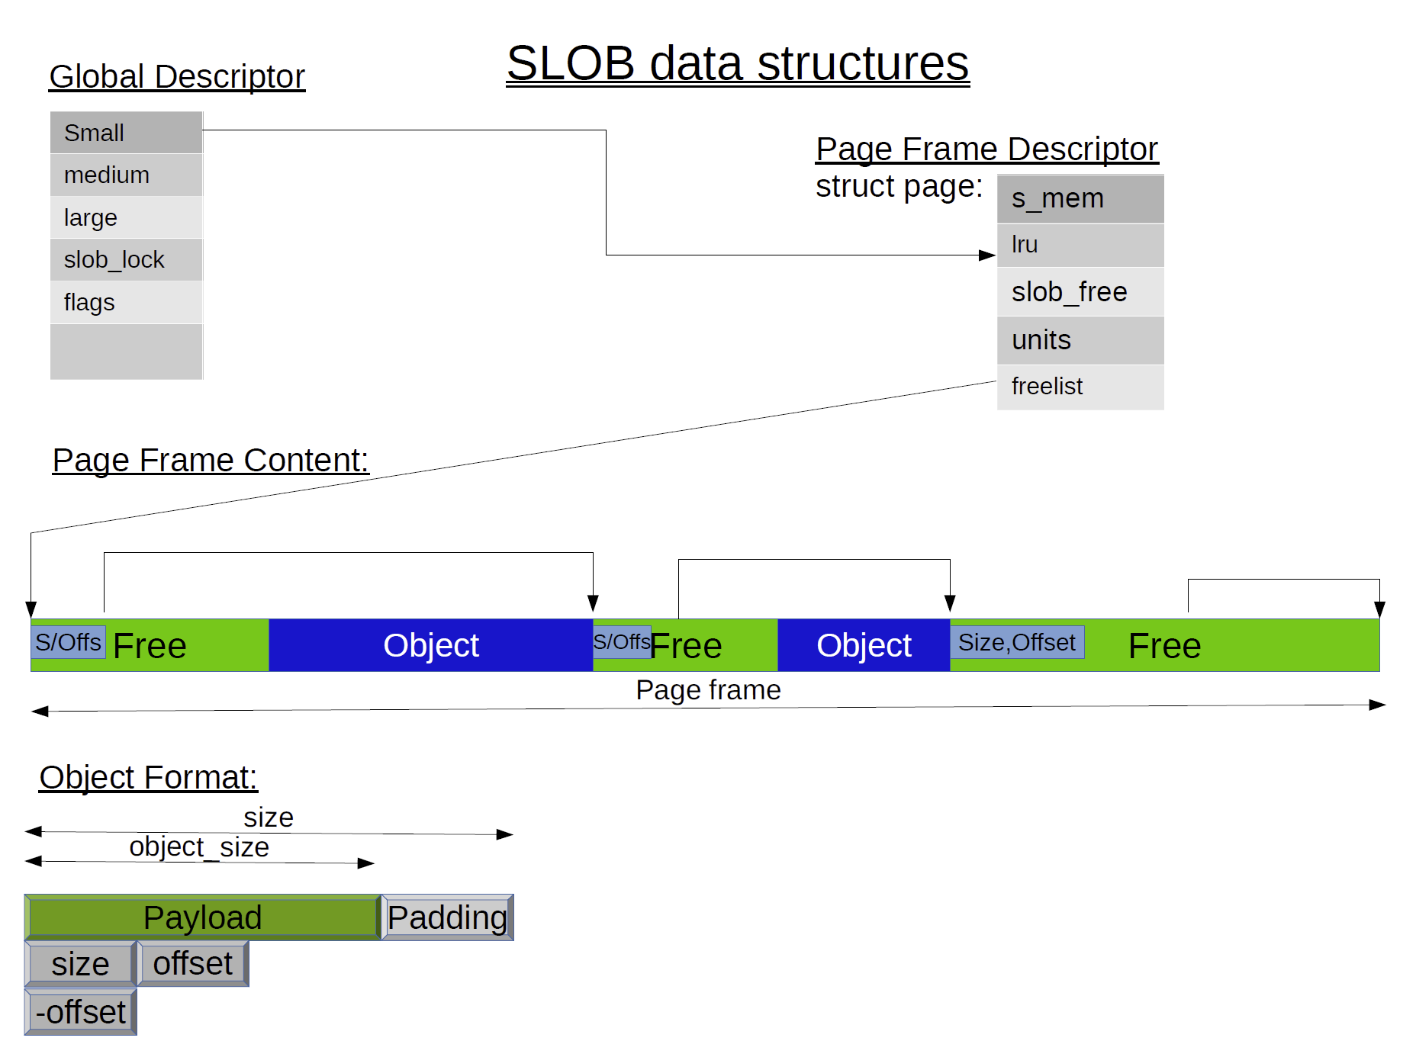
The SLOB Allocator
Source: Christoph Lameter, LinuxCon 2014

Slide 79
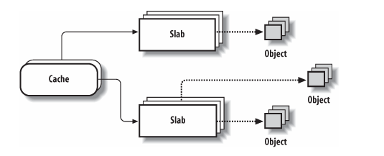
The SLAB Allocator
Pioneered by Solaris OS
Based on the idea of caches
Each cache stores objects of the same type (hence size)
Insight: the OS works often with objects of particular types
In general, 26 general cache descriptors associated with memory areas of size 32 bytes to 128Kbytes.
For each size, there are two caches: one suitable for ISA DMA allocations and the other for normal allocations.

Slide 80
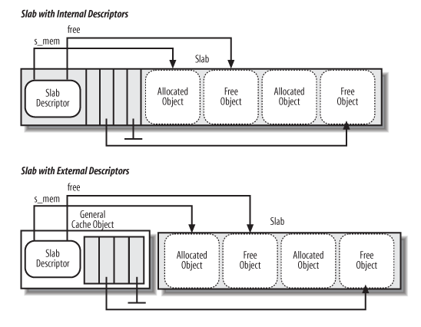
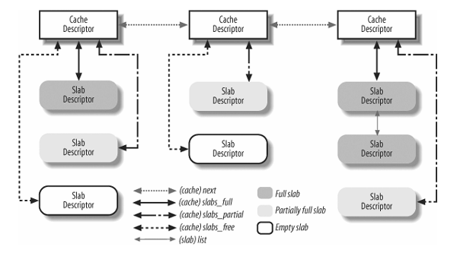
The Descriptors
The objects managed by the slab allocator are aligned in memory.
If the object’s size is greater than half of a cache line, it is aligned in RAM to a multiple of L1_CACHE_BYTES.
Otherwise, the object size is rounded up to a submultiple of L1_CACHE_BYTES
Ensures that a small object will never span across two cache lines.

Slide 81
Allocating and deallocating slabs
A slab consists of a few contiguous pages
A slab is allocated when there is no free space available on an allocation request
Caches are empty when created until the first allocation request
Slabs are destroyed when there are too many free objects

Slide 82
Slab coloring
Objects that have the same offset within different slabs may (with high probability) land in the same cache line
Risk cache thrashing
There will be some free space in a frame
Will be less than an object
Idea: use a “colour” to offset the addresses in the frame
Different colour slabs will have different initial offset of the first object

Slide 83
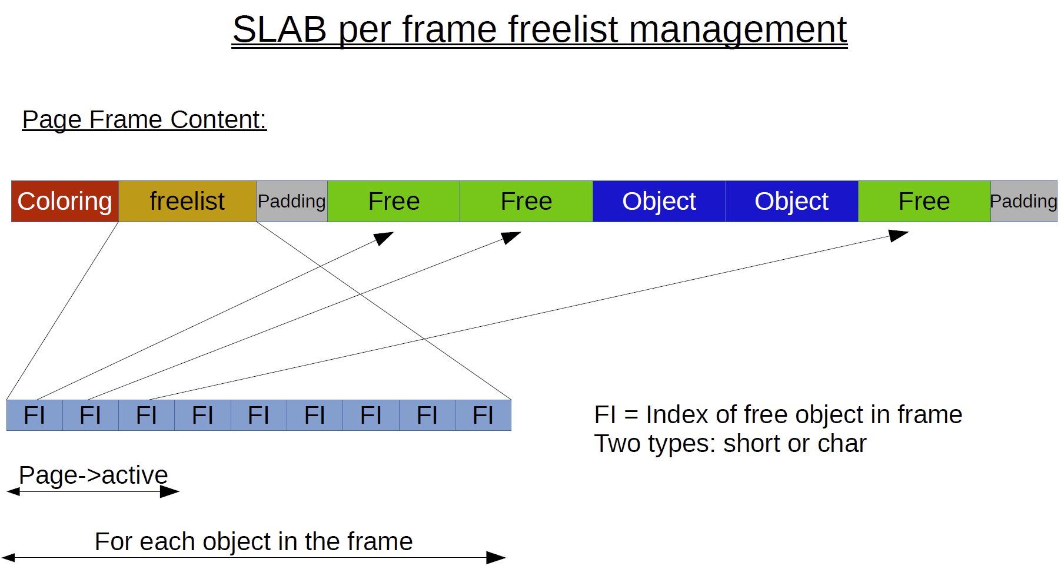
The SLAB data structure
Source: Christoph Lameter, LinuxCon 2014

Slide 84
The SLUB Allocator
Improved version of the SLAB allocator
Improved support for debugging
Off by default

Slide 85
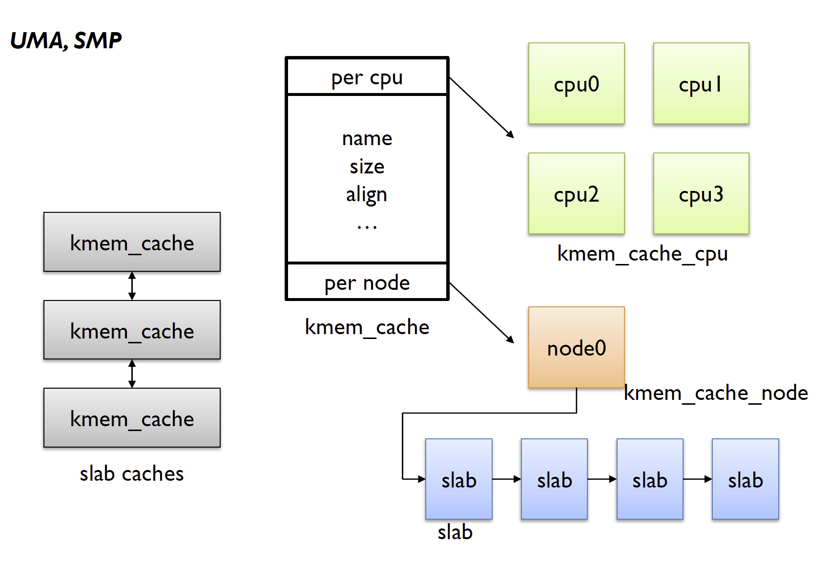
SLUB Data Structures

Slide 86
NUMA Nodes
Non Uniform Memory Access (NUMA): each processor has its own local memory
Unlike Distributed Memory Architecture, the memory of other processor is accessible but the latency to access them is not same.
A NUMA node is a group of CPUs connected to the same local memory
A node uses the interconnection network to access memory on other nodes
Multiple NUMA Nodes can be added to form a SMP
A popular variant is cache-coherent NUMA where the work to access remote nodes is handled by hardware and transparent to users
Linux memory system can deal with NUMA nodes

Slide 87
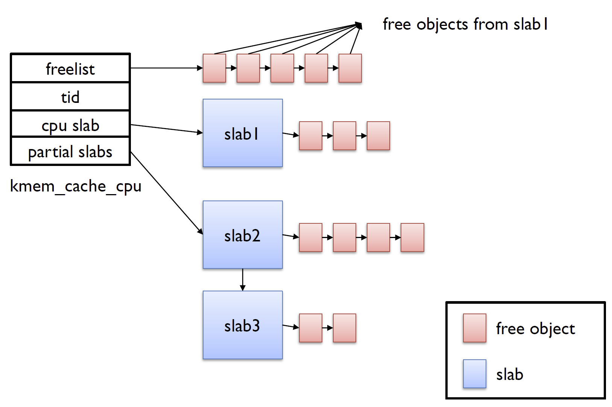
Per-CPU lists

Slide 88
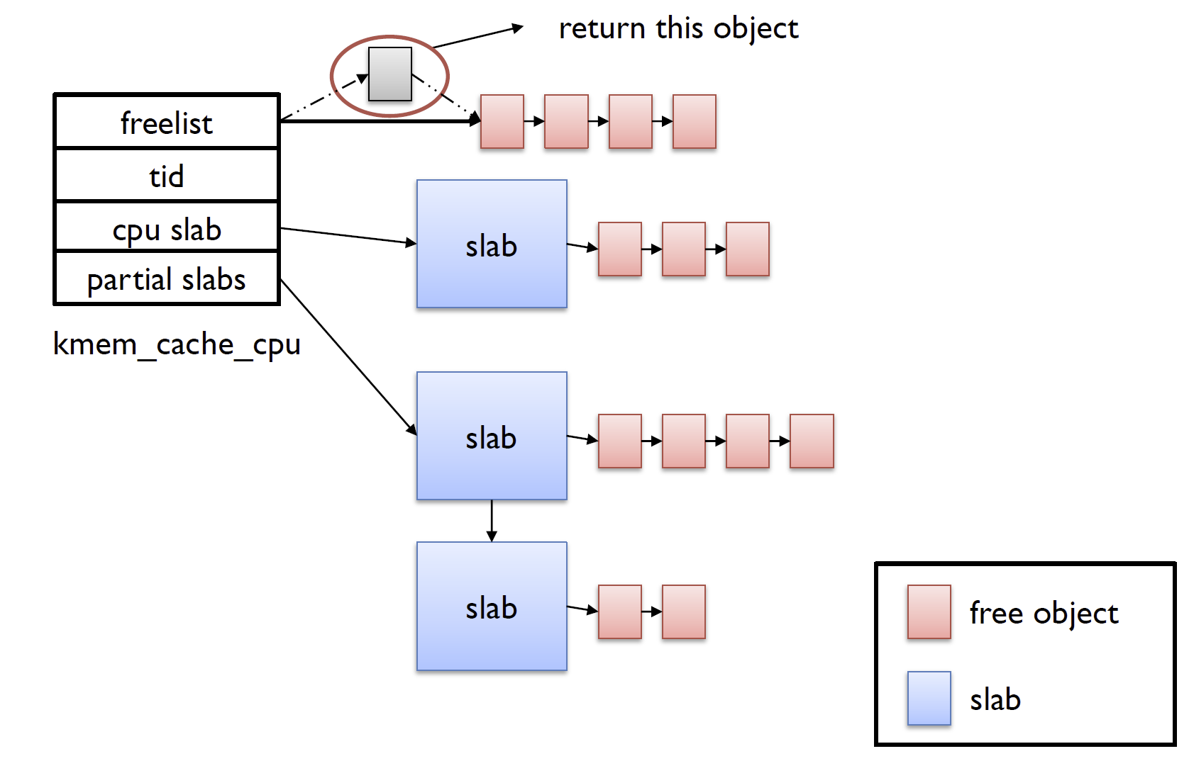
Allocation: Fast Path

Slide 89
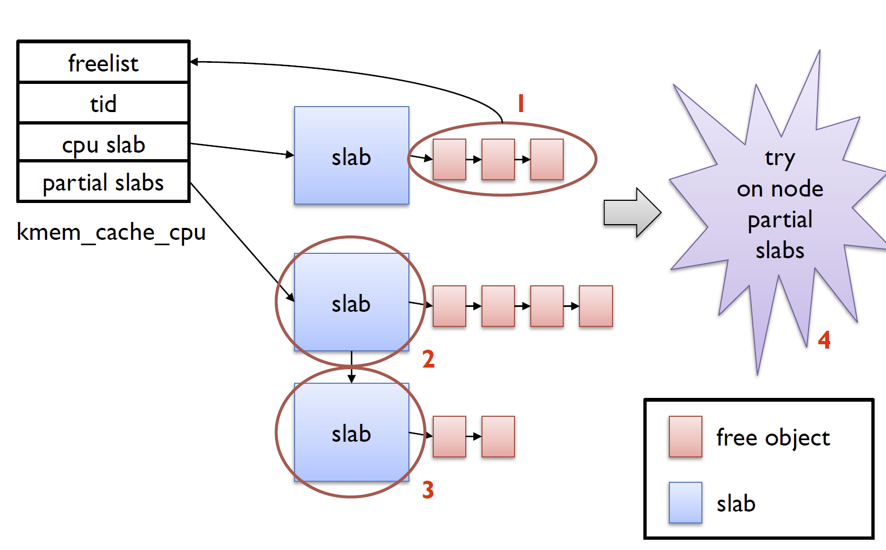
Allocation: Slow Path

Slide 90
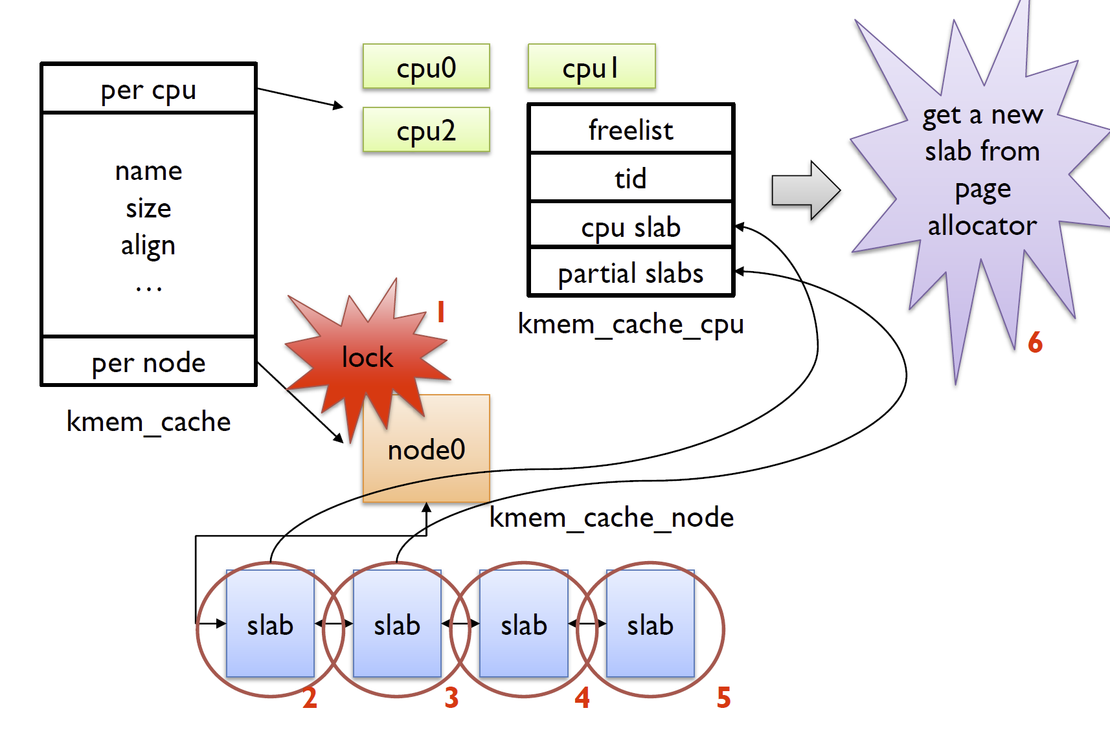
Allocation: Very Slow Path

Slide 91
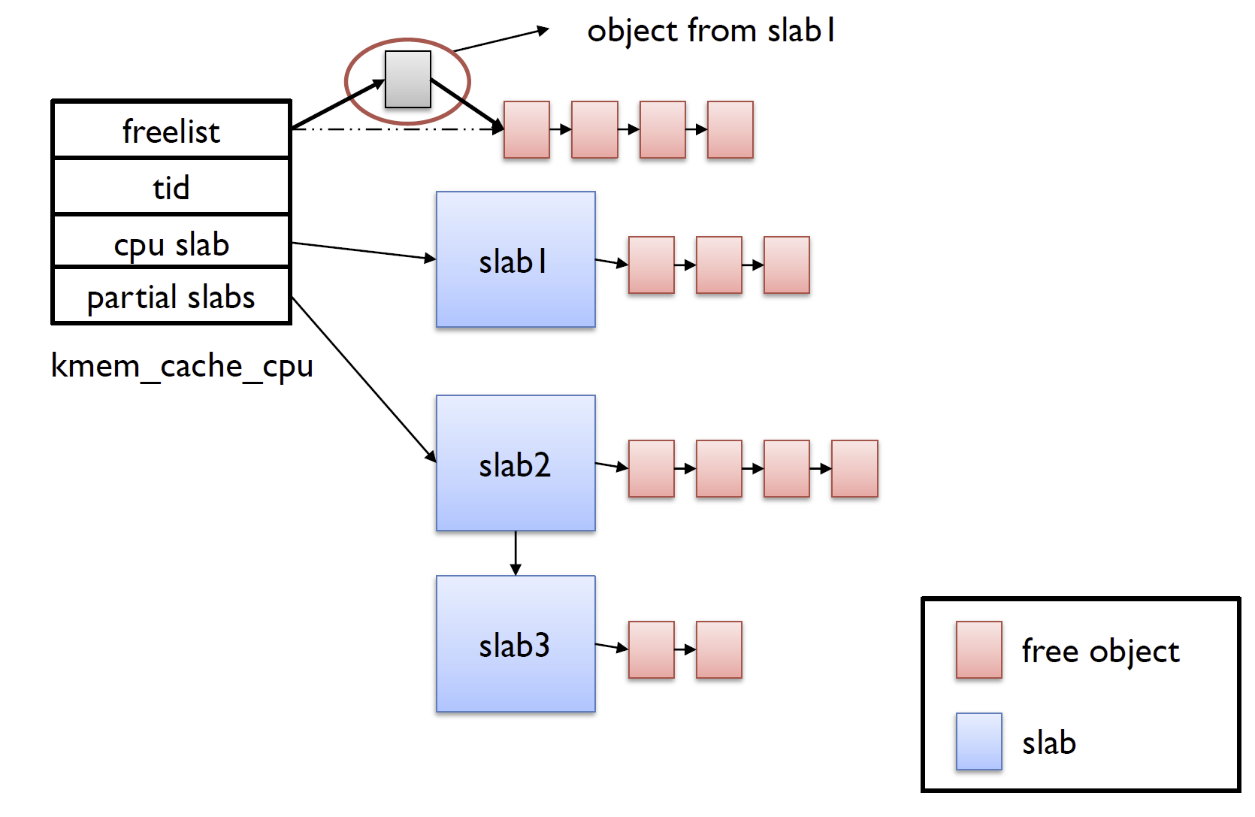
Free: Fast Path

Slide 92
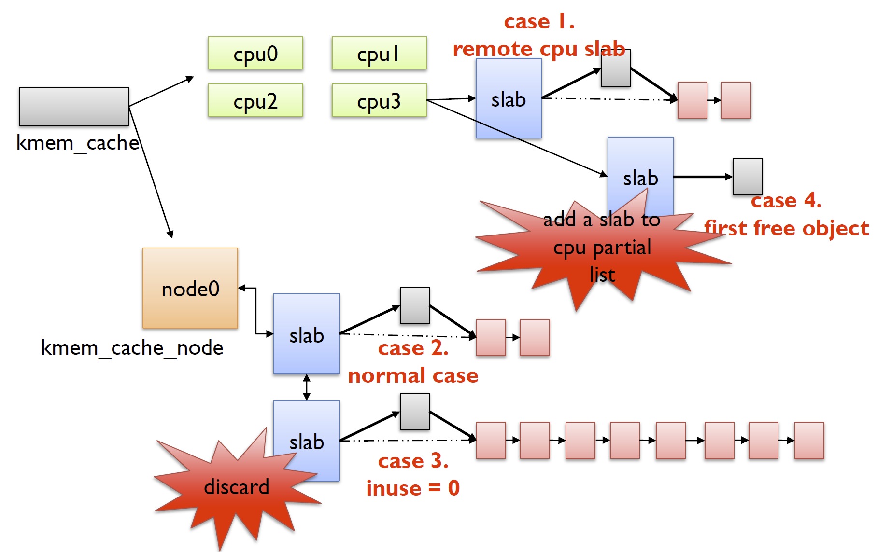
Free: Slow Path

Slide 93
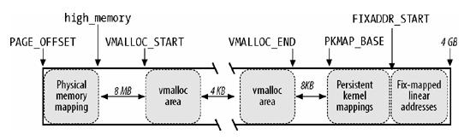
Noncontiguous Memory
For infrequent memory allocation requests with no hard requirement of being in contiguous page frames
Virtual (linear) address can still be contiguous
Used for swap areas and modules
Access via the vmalloc() interface
(for 32bit kernel)

Slide 94
The Page Fault Handler

Slide 95
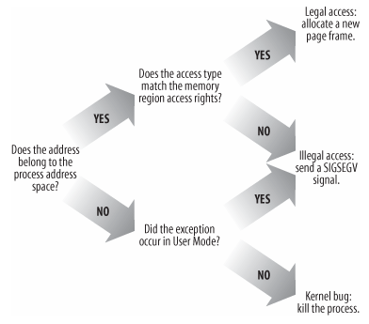
Page fault
Page size in Linux is 4KB
On a page exception
Is the page already in a frame?
Does the process have permission to access it?
If page not in frame, must take further action.
The kernel itself can also page fault but only to handle copying to and from userspace.
The Linux kernel itself is NOT PAGEABLE.
Kernel threads may be holding locks, or disabled interrupts

Slide 96
Page fault on x86
Entry point do_page_fault() in arch/x86/mm/fault.c
Linear address causing the fault is captured in CR2
Minor fault: do not need to block the current process
Major fault: must put current process to sleep
Demand paging
VM_FAULT_OOM: Out of memory, cannot find a page frame, kill process
Executes the flowchart

Slide 97
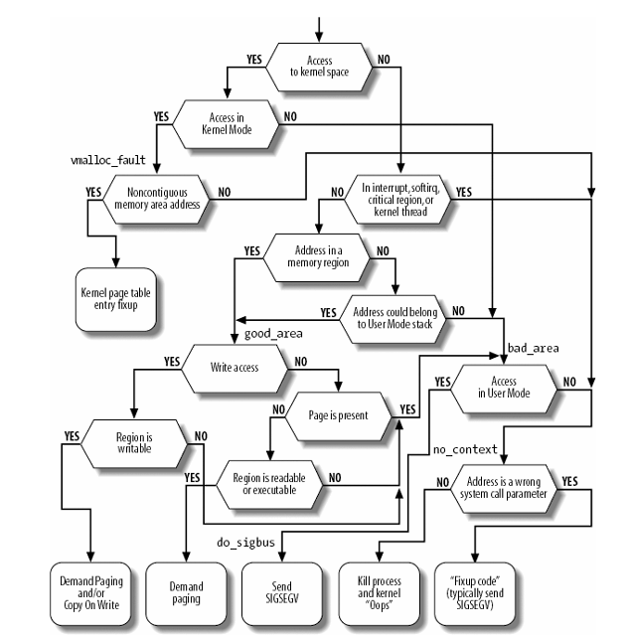
The flow diagram

Slide 98
Page Frame Reclamation and Swapping

Slide 99
The issues
Page frames are precious resource
Even when allocated, they may not stay committed to the same process for its entirety
Memory allocators (user and kernel) allocate and deallocate memory but page frames even if allocated may be “swapped out”
Another complication: several page table entries may point to the same frame
If a frame is reclaimed, and a PTE is not updated correctly, OS is incorrect
How to find it?

Slide 100
Goal of PFRA
To ensure system is functioning with a healthy availability of free page frames
Unfortunately, different workload imposes different needs
Empirical heuristics used in its design
Hard to formulate a theoretical framework

Slide 101
Page Frame Reclamation Algorithm (PFRA)
The core algorithm for “stealing” page frames to increase the free list of the buddy system
It is performed before all free frames are used up
Otherwise, could crash the system
PFRA itself need to use frames to work

Slide 102
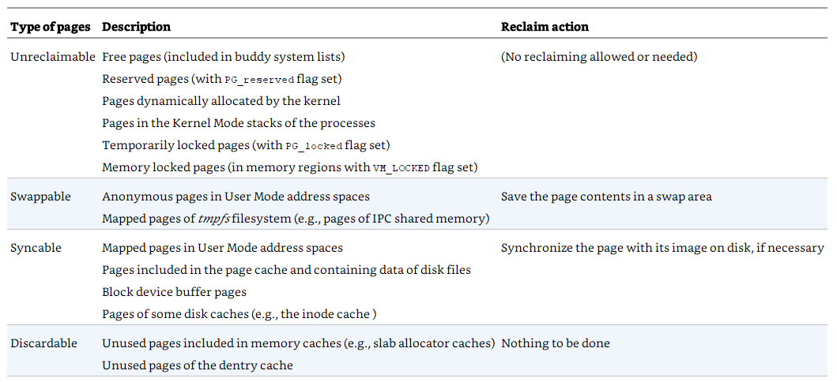
The Four Types of Page Frames
Source: Bovet, Daniel P. Understanding the Linux Kernel.

Slide 103
Mapped vs Anonymous
A page is said to be mapped if it is part of a file
To reclaim a mapped page, check if it is dirty (i.e., has been written to) and write the content to the corresponding file
A page is anonymous if it is not mapped
Content must be saved to a dedicated disk partition or disk file called the swap area

Slide 104
Shared vs Non-shared page frames
A page frame is shared if it belongs to more than one user process
Note: the same shared page frame may be mapped to altogether different virtual addresses in different processes – or even in the same process
Otherwise, it is non-shared

Slide 105
General principles of Linux PFRA
Free “harmless” pages first
Examples: infrequently used pages of various caches in the kernel
Make all user mode pages reclaimable
Reclaim a shared page frame by unmapping all PTEs referencing it in a single go
Reclaim “unused” pages only

Slide 106
Reverse Mapping

Slide 107
Reverse Mapping
Aim: to quickly locate all page table entries point to the same page frame
Trivial solution: keep a reverse pointer in each page descriptor to chain up the PTEs
Keeping such a list up to date requires too much work

Slide 108
Object-based Reverse Mapping
Introduced in Linux 2.6
Recall: every page frame has a corresponding page descriptor
Page descriptor has two fields: _mapcount and mapping
_mapcount
-1 : no PTE points to this page
0 : page is non-shared, only one PTE points to it
> 0 : page is shared, _mapcount number of PTEs point to it
page_mapcount() returns _mapcount + 1

Slide 109
mapping field
If null, the page belongs to the swap cache
A cache for moving pages to and from swap disk
If non-null, and LSB is 1
Page is anonymous
Mapping field is points to an anon_vma descriptor
If non-null, and LSB is 0
Page is mapped
Mapping field points to the address_space object of the page cache

Slide 110

Reverse Mapping for Anonymous Pages
A doubly linked list collects all the memory regions that include the same page frame
Source: Bovet, Daniel P. Understanding the Linux Kernel.

Slide 111
Reverse Mapping for Anonymous Pages
When first page frame is assigned to an anonymous region, a new anon_vma is created
When a page frame already referenced by one process is inserted into a PTE of another process, the kernel simply inserts the anonymous memory region of the second process in the doubly linked circular list of the anon_vma data structure pointed to by the first process
To find all other PTEs for a page frame to be reclaimed is a linear traversal of the list

Slide 112
Reverse Mapping for Mapped Pages
Similar to above except use address_space instead of anon_vma
Earlier methods of using priority search tree did not seem to survive

Slide 113

Page Reclamation
Source: Bovet, Daniel P. Understanding the Linux Kernel.

Slide 114
Page Reclamation

Slide 115
Page reclamation for mapped page frames
Also known as demand paging
For each memory zone, two LRU (“clock”) lists – the active and inactive lists – of pages are maintained
Page fault
Inactive
Demote
Active
Reclaim
Promote

Slide 116
Per zone, dual clock list
Aim: to capture the working set of the process
Freshly faulted pages start out at the head of the inactive list
Page reclaimation scans pages from the tail of the inactive list
Pages that are accessed multiple times on the inactive list are promoted to the active list
Active pages are demoted to the inactive list when the active list grows too big
Once in the active list, one’s position is not updated

Slide 117
Working set
A workload is thrashing when its pages are frequently used but they are evicted from the inactive list every time before another access would have promoted them to the active list
When the average access distance between thrashing pages is bigger than the size of memory there is nothing that can be done
Otherwise, the scheme approximates the working set of the process

Slide 118
Overhead
Too expensive to accurately track access frequency of pages
A reasonable approximation can be made to measure thrashing on the inactive list

Slide 119
Observations
When a page is accessed for the first time in the inactive list, it is added to the head of the inactive list, and pushes the current tail out of memory (“evicted”)
When it is accessed for the second time, it is promoted (“activated”) to the active list, shrinking the inactive list by one slot
The sum of evictions and activations in a given period of time indicates the minimum number of inactive pages accessed in this period
Moving one inactive page N page slots towards the tail requires at least N inactive page accesses

Slide 120
Insights
When a page is finally evicted from memory, the number of inactive pages accessed is at least the number of slots in the inactive list
Measuring the sum of evictions and activations (E) at the time of a page's eviction, and comparing it to another reading (R > E) at the time the page faults back into memory tells the minimum number of accesses while the page was not cached
This is called the refault distance

Slide 121
Minimum Access Distance
Minimum Access Distance = NR_inactive + (R – E)
In other words, the refault distance can be seen as a deficit in inactive list space
If the inactive list had (R – E) more page slots, the page would not have been evicted in between accesses, but activated instead
Heuristic: place page in active list (“activate”) if (R – E) < NR_active

Slide 122
Implementation
Maintain a counter for inactive evictions and activations for each zone
On eviction, a snapshot of this counter (along with some bits to identify the zone) is stored in the now empty page cache radix tree slot of the evicted page.
This is called a shadow entry
On page cache misses for which there are shadow entries, an eligible refault distance will immediately activate the refaulting page.

Slide 123
Modified flow
Page fault
(R – E) < NR_ACTIVE?
Yes
No
Reclaim
Inactive
Active
Demote
Promote

Slide 124
The Page Cache

Slide 125

The Linux Storage Stack

Slide 126
The Page Cache
Caches pages originating from reads and writes of regular filesystem files, block device files, and memory-mapped file
It is the “bridge” between the memory and disks
When the kernel tries to read from a file, it will check if it is in the page cache.
If so, it will return those pages.
If not, schedule an I/O operation that will read from (parts of) disk files into the page cache

Slide 127
History
Before kernel 2.2, there exist a page cache and a buffer cache
Page cache for pages, buffer cache for VFS blocks
Blocks are unit of transfer for block devices
Block size is device dependent and may not be the same as the page size
Since kernel 2.4, there is only the page cache
Has instead buffer page - a page of data additional descriptors called “buffer heads ,” for quick location of disk address of each individual block in the page

Slide 128
Write Caching
Linux uses write-back caching
On a file write request, data is written into the page cache. Those written to pages are marked dirty
Periodically, dirty data is written back to disk (eviction)

Slide 129
address_space – the page frames of a file
struct address_space {
struct inode *host; /* owner: inode, block_device */
struct radix_tree_root page_tree; /* radix tree of all pages */
spinlock_t tree_lock; /* and lock protecting it */
atomic_t i_mmap_writable;/* count VM_SHARED mappings */
struct rb_root i_mmap; /* tree of private and shared mappings */
struct rw_semaphore i_mmap_rwsem; /* protect tree, count, list */
/* Protected by tree_lock together with the radix tree */
unsigned long nrpages; /* number of total pages */
/* number of shadow or DAX exceptional entries */
unsigned long nrexceptional;
pgoff_t writeback_index;/* writeback starts here */
const struct address_space_operations *a_ops; /* methods */
unsigned long flags; /* error bits/gfp mask */
spinlock_t private_lock; /* for use by the address_space */
struct list_head private_list; /* ditto */
void *private_data; /* ditto */
} __attribute__((aligned(sizeof(long))));

Slide 130
Noteworthy fields
i_mmap: all the memory mappings (private or shared) captured in a red-black tree
page_tree: for fast query about the existence of a page in the page cache (coz files can be huge and only a small portion of pages are cached)
Organized as a radix tree

Slide 131

General Radix Tree Example
Wikipedia: Radix trees are useful for constructing associative arrays with keys that can be expressed as strings
Linux: used for looking up integers
Source: Wikipedia

Slide 132
Radix tree from addresses example
0x12: 0000 0000 0000 0001 0010
0₁₀
18₁₀
0
0x14: 0000 0000 0000 0001 0100
0₁₀
20₁₀
0
2
38
46
0xbc: 0000 0000 0000 1011 1100
2₁₀
60₁₀
18
20
60
57
5
0x9b9: 0000 0000 1001 1011 1001
38₁₀
57₁₀
0xb85: 0000 0000 1011 1000 0101
46₁₀
5₁₀

Slide 133


Radix tree in Linux
Page index = position of a page inside the file
Source: Bovet, Daniel P. Understanding the Linux Kernel.

Slide 134
Radix tree in Linux
Treat the bits in the page index as a “bit string”
Take 6-bits at a time
Level 1 – bits 0-5
Level 2 – bits 6-11
Level 3 – bits 12-17
Level 4 – bits 18-23
Level 5 – bits 24-31
Level 6 – bits 32-37
Either null (not found), or a next level internal node, or a page descriptor pointing to the page (found)
Source: Bovet, Daniel P. Understanding the Linux Kernel.

Slide 135
Page Cache Eviction
When space is low in the page cache, eviction is triggered
First try to evict clean pages
If not enough, force writeback of some dirty pages using LRU

Slide 136
Per-backing-device based writeback
Prior to kernel 2.6.32, flushing to backing device was done by pdflush kernel thread
Now, each backing device has dedicated kernel thread for flushing
“flush-MAJOR”
Threads are created when there's flushing work that needs to be done and will disappear after a while if there's nothing to do

Slide 137
Backing device
Block device – transfer units of blocks
As opposed to “char devices” with transfer unit of a character
Different block devices have different block sizes
Examples: hard disks, tapes, etc.
A backing device is a block device whose content may be cached in memory
Provides an abstract interface to get to the device driver to do common operations like read or write
Info for all available backing devices held in a list, bdi_list
Added writeback functionality to support page cache eviction

Slide 138
Swapping

Slide 139
The need to swap
Pages that belong to an anonymous memory region of a process (User Mode stack or heap)
Dirty pages that belong to a private memory mapping of a process
Pages that belong to an IPC shared memory region

Slide 140
Work of the Swapping Subsystem
Set up “swap areas” on disk to store pages that do not have a disk image.
Manage the space on swap areas allocating and freeing “page slots” as the need occurs.
Provide functions both to “swap out” pages from RAM into a swap area and to “swap in” pages from a swap area into RAM.
Make use of “swapped-out page identifiers” in the Page Table entries of pages that are currently swapped out to keep track of the positions of data in the swap areas.

Slide 141
Swap Area
May be a disk partition or a file included in a larger partition
Up to MAX_SWAPFILES (usually 32) may be used
Each swap area consists of a sequence of page slots
Each slot holds the content of a page, i.e., 4096 bytes
Page slots are organized into swap extents – a contiguous group that is also contiguous physically on disk
Normally, in a disk partition, one swap area is one swap extent while if in a file, a swap area consists of several swap extents
First page slot of a swap area is used to contain meta information

Slide 142

Data structure of a swap area
Source: Bovet, Daniel P. Understanding the Linux Kernel.

Slide 143
Swap-out Page Identifier
A page that is swapped out is identified by:
The swap area it is in
7 bits at the moment
The page slot index
Usually stores as an “unsigned long”
Actual size is architecture dependent

Slide 144
Race conditions during swapping
Multiple swap-ins: Two processes may concurrently try to swap in the same shared anonymous page.
Concurrent swap-ins and swap-outs: A process may swap-in a page that is being swapped out by the PFRA.
Solution: swap cache

Slide 145
The Swap Cache
A collection of page frames
Key rule: nobody can start a swap-in or swap-out without checking whether the swap cache already includes the affected page
Pages in swap caches are in page frames
If in swap cache, get a lock for the corresponding page frame

Slide 146
How the swap cache resolves races
Process A: wants to swap in a page
Kernel checks if page is in swap cache; suppose it is not
Kernel allocates a new page frame for the incoming page and mark it locked
Process B: wants to swap in same page
Kernel checks if page is in swap cache – it is, and it is locked
Process B goes to sleep waiting for page to be ready

Slide 147

Page reclamation and the Swap Cache
Process A:
Process B:
Process A and B shares
the same page frame, P
Source: Bovet, Daniel P. Understanding the Linux Kernel.

Slide 148
Page reclamation and the Swap Cache
PFRA selects page frame P for reclamation; inserts page frame into swap cache

Slide 149
Page reclamation and the Swap Cache
PFRA marks both Process A and B’s PTE to point to swap area page slot. PFRA starts writing content of page to disk

Slide 150
Page reclamation and the Swap Cache
In the middle of it all, suppose Process B wants to read from the page. Page fault handler will find the page in the page cache and direct B to it.

Slide 151
Page reclamation and the Swap Cache
However, if write completes without interference, Process A and B will be pointed to the page slot

Slide 152
Allocating and Freeing Page Slots in the Swap Area
Swapping (because of high disk access overhead) is batched
Allocation will be for a batch of pages
The pages themselves may or may not be contiguous in virtual memory
But they will sit in contiguous space
A “first used” and “first free” pointer is maintained in the swap area info
Scans from these to find free slots

Slide 153
Swapping In Pages
Check swap cache, if page is there, skip to Step 3
Read in pages from disks
For each page, check page cache by looking up radix tree, check swap cache before trying to read from disk
Check page cache by looking up radix tree, check swap cache again – to make sure we got all pages in correctly
Tricky race conditions and various technical issues can trip up 2
Free swap area page slots
Fix up page table entries of process

Slide 154
Swapping out pages
Insert pages into swap cache
Get allocation of swap area page slots
Update page table entries
Write pages into swap area

Slide 155
Regular maintenance
kswapd – Kernel Swap Daemon
Periodically frees a number of pages each time it runs
Don’t free too many! That will create lots of I/O
cache_reap
Called periodically to clear pages in the slab

Slide 156
zswap
A compressed write-back cache for swapped pages
Memory is getting big these days
I/O to disk is still slow
Trade I/O with computation and memory
Instead of moving memory pages to a swap device when they are to be swapped out, zswap compresses and then stores them into a memory pool dynamically allocated in the system RAM

Slide 157
End

